Slide 1



https://www.costaid.eu
Module 5 Ethics
Funded by the European Union. Views and opinions expressed are however those of the author(s) only and do not necessarily reflect those of the European Union or the European Education and Culture Executive Agency (EACEA). Neither the European Union nor EACEA can be held responsible for them.

Slide 2






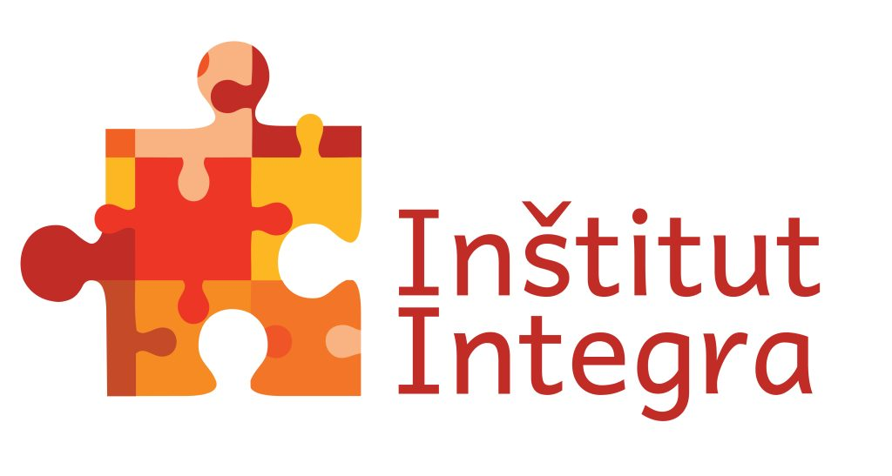

Partners

Slide 3
Modules
4. Enabling dialogue
5. Ethics
6. Reflective skills
7. Digital skills
1. Awareness
2. Critical thinking
3. Conflict solving

Slide 4

Objectives
This module provides more information on ethics and its connection to beliefs, values, attitudes and culturally based moral principles.
Explains how to deal with ethical dilemma.
Describes what is professional ethics.
Teaches how to ethically use AI without biases and how to apply ethics in public speaking or on social media.

Slide 5
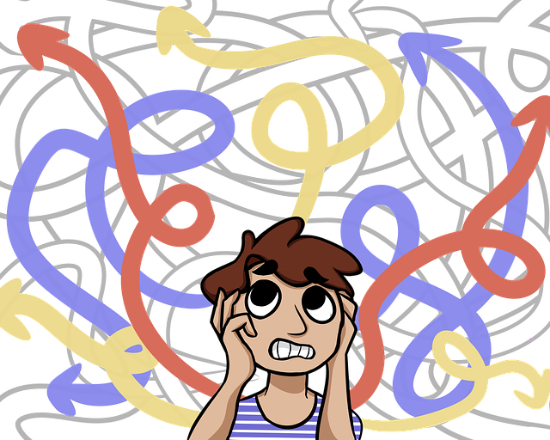
Ethics
Whenever you ask yourself ‘what should I do?’ or ‘how should I act?’ or ‘is this the right thing to do?’ you are making an ethical decision.
Ethics means the set of moral principles all human beings should possess, that reflect what is right.
Personal ethics refers to the ethics that you as a person identifies with (beliefs, values, attitudes, culture), in respect to people and situations that you encounter in everyday life.
Professional ethics refers to the ethics that a person must adhere to in relation to his or her interactions and relationships in professional life.
Source | Pixabay license

Slide 6

Beliefs
Belief
is a state or habit of mind in which trust or confidence is placed in some person or thing.
click
A belief is an idea that a person holds as being true. Belief can originate from various sources, such as:
  a person’s own observations or experiments;
  the adoption of cultural and societal standards (e.g. religion);
  what others tell them (e.g. education or mentoring).
A possible belief stays with the person until they embrace it as true and incorporate it into their individual belief system.
Each person assesses and seeks solid reasons or evidence for these possible beliefs in their own way.
Once a person acknowledges a belief as a truth, they are ready to defend, it can be said to constitute part of their belief system.

Slide 7

Values
Values are stable long-lasting beliefs about what matters to a person. A value emerges from a belief when the person becomes more dedicated to it and considers it as significant.
A person must be able to express one´s values clearly in order to make clear, reasonable, responsible and consistent decisions.
It is possible to divide beliefs into different types of values. These types of values are related to or pertain to:
    happiness,
    wealth,
    career success,
    family.
Source | Pixabay license

Slide 8
Attitudes
Some tips how to cultivate your self-awareness and thus your attitudes:
Be curious about who you are
See behind your walls
See yourself clearly
Ask other how they see you
Keep a journal
click
Attitudes are the mental states that influence how people decide and act in different situations and towards others. They are mainly shaped by people's values and beliefs, which are their fundamental principles and convictions.
Other factors that are not deeply ingrained in people's minds can also affect their attitudes in the moment of decision making.
These include social norms, conventions, peer pressure, and emotional stress.
Lack of self-awareness or critical insight, or the existence of ambivalence or insecurity in values, can lead to a less rational way of approaching to choices and as a result to undesirable behaviour.
The potential for these influences to affect attitudes will be greater if the person has not clearly thought through their beliefs and values. This process involves considering the principles by which they might align or prioritise competing values.

Slide 9

The code of morals and culture
Every culture has its own moral code. Traditional notions of morality or value system may be quite different and cultural groups may have completely different approaches to truth and deception. There is also a moral code on a personal level that is influenced by soft skills such as:
Assertiveness - especially in individualistic societies is valued because it leads a person to direct, self-conscious action that promotes his interests. This is problematic for cultures that do not have assertive action integrated into their social components and therefore they may have difficulty with such action.
Self-enhancement - tendency to present a more positive image of oneself than the reality, a tendency to improve desired qualities.
Self-criticism - inability to adequately evaluate one's own performance, activity or accomplishments. Underestimation of one's abilities that does not correspond to the real reality.
This is also connected with the untruthfulness in social media communication and with attitude to spread mis- or dis-information.
Source | Pixabay license

Slide 10

Ethical Dilemmas
In the context of ethics, there is also the issue of the ethical dilemma. An ethical dilemma is the process of deciding between two possible courses of action, both of which are in some way ethically unacceptable.
Every person encounters ethical dilemmas during their life, when moral principles are challenged.
It may be extremely complicated problem or one with relatively difficult solution.
This process is supported by your critical thinking skills or your cultural background and the option you chose may help you to become respected as a person or a professional.
Source | Pixabay license

Slide 11
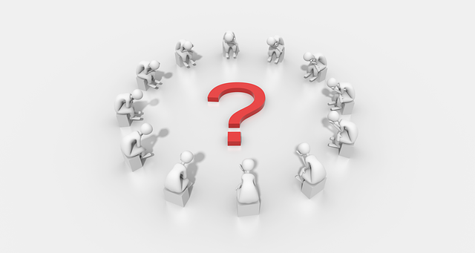
Example of Ethical Dilemmas
Common ethical dilemmas include the temptation to intentionally misinterpret the data.
Someone might be tempted or encouraged to share a data in such a way to sway or misled the clients that their choice is the most secure.
So, ethical dilemma would be whether person will misinterpret the data and secure his/her career or share the truth and risk losing the job.
Source | Pixabay license

Slide 12
Other ethical dilemmas (professional and personal)
Monitoring social media of children or teens – From a safety point as a parent, should you monitor your teenager’s online activities, or are they old enough to use social media responsibly?
Selling something without disclosing all negative data.
Reporting an accident – If you are in hurry and you pass by an accident, would you report it? Or you will tell yourself there will be another person who would likely to call the authorities?
Should I lie to my boss? – You may find that you agree it is fine to lie to your boss in certain situations. However, does lying to your boss on any level go against your personal moral beliefs? If so, that will create your moral dilemma.
Is it okay to take supplies from my office?
Aborting a child with Down Syndrome. – The dilemma basically comes down to the question: how does an abortion fit into your moral beliefs?

Slide 13

The most important...
The most important thing while dealing with dilemmas is:
consider all the facts, then figure out whether you have the control to make the decision needed before moving forward.
be honest with yourself, keep your integrity and morality paramount.
if you done that, once you've made your choice, you'll have the satisfaction that you've chosen wisely.
It is helpful to assess each choice objectively and opt for the greater good.
Source | Pixabay license

Slide 14

Professional ethics
We already touched a professional dilemmas in previous part.
Applying ethics in a professional environment is essential for maintaining trust, integrity and respect among colleagues, clients and stakeholders. It can enhance one's reputation, credibility and performance, as well as foster a positive and productive work culture.
The term business or professional ethics refers to the set of moral principles that guides a company's conduct.
Source | Pixabay license

Slide 15
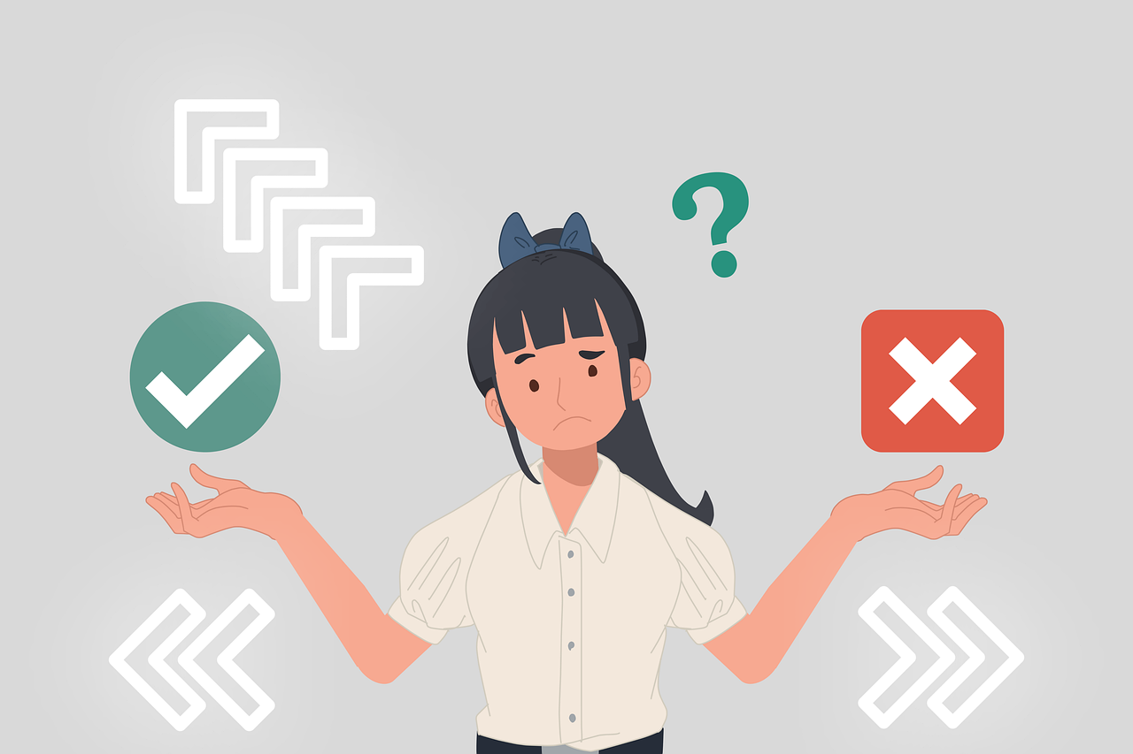
What are professional ethics?
Professional ethics are principles that govern the behaviour of a person or group in an organisational environment. Like values, professional ethics provide rules on how a person should behave towards other people and organisations in such an environment.
Professionals need to understand the difference between the personal values and ethics that they hold as individuals, and the professional ethics that they must follow as members of professional organisation.
Source | Pixabay license

Slide 16
Why is professional ethics important?
Companies, schools or public bodies demonstrate their ethics by complying with all relevant laws. This protects them from legal issues and builds their reputation among their peers and customers. Business ethics, or company´s ethical codes also help companies recruit quality team members. Organisations that value and respect their team members according to high ethical standards are often appealing to job seekers.
There are several parts of professional ethics:
  Personal responsibility
  Corporate responsibility
  Loyalty
  Respect
  Trustworthiness
  Fairness
  Social and environmental responsibility

Slide 17
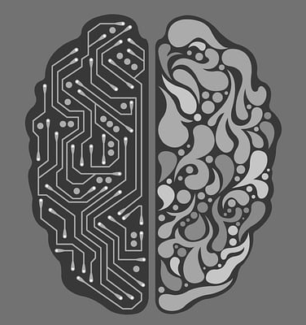
Ethical principles for the use of AI
The impact of the use of AI is possible to see in almost all sectors of the economy and in people's everyday lives.
Applying ethics for the use of AI in working environment is more important with every day. Respect to human dignity, rights, and freedoms are basic rules in designing and developing AI.
Also, OECD created a working group which is working on „principles of use of AI in the workplace, including in terms of human rights (bias, privacy, agency and dignity), transparency and ability to explain, robustness security and safety, and accountability and liability.“
The impact of AI on education has potential to improve and transform the process especially with ChatGPT, but it has also risky side. It is expected, that new ways of teaching will be necessary to adapt.
Trainers and teachers will face many challenges, both in terms of skills acquisition and within the spread of fake news, photos and videos generated by AI.
Source | Pixabay license

Slide 18
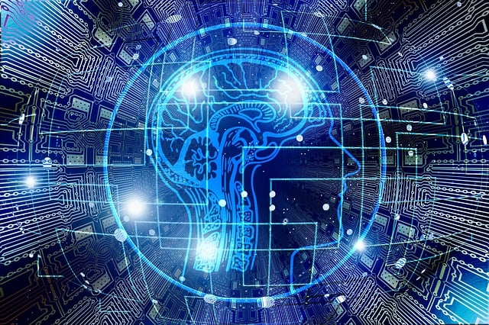
Biases within AI
AI systems can be unfair if you are using them, for example, for surveying purposes. They use big data and search engines to display results that are often clicked on, but these are dependent on who clicks on them, what they like and which country they are from, and therefore such results can be unfair and biased. Thus, a search engine can replicate the same biases that exist in the real world and reinforce them in the online environment.
It is important to be aware that AI works with what is available, and this content many times condenses unethical messages, injustice, prejudices, aggression and attempts to obfuscate the truth.
Source | Pixabay license

Slide 19

Ethics in Social Media
Social media connects us in our everyday lives and influence us in our views and opinions. They are powerful source of information, but on the other side they are also source of information disorders.
Messages of violence try to be persuasive and try to change individual´s beliefs or intentions.
Online (or face to face) hate speech or microaggression is an ethical dilemma. On the one side it is a freedom of expression, but on the other side there is the right of others for dignity and respect. It is important to condemn communications that demean individuals, groups or humanity through distortion, intimidation, coercion and violence, and the expression of intolerance and hatred.
Disrespect to the ethical core principles could lead to problems with distinguishing the truth, to the manipulation and/or to the mis-interpretation of the truth.
Source | Pixabay license

Slide 20

Ethics in Public Speaking
Public speaking also has several ethical principles which are core stone to be learned by all:
Trustworthiness
Integrity in the subject matter
Respect for others
Dignity in conduct
Truthfulness in message
To be honest in conveyed information is the core principle.
Nowadays, we need to be careful about the source of information even when speaking in public. Speakers often use exaggeration, omission, or distortion of information to make their point more convincing. It is important, if possible, to ask the speaker questions or to inquire directly about the source of his or her statement. The skills to critically reflect and enquire needs to be developed in educators, and through them, in young people and students.
Source | Pixabay license

Slide 21
References and further reading
Belief. (2023) Merriam-Webster Dictionary. Retrieved from: https://www.merriam-webster.com/dictionary/belief
CFI Team. (2020) Ethical Dilemma. Retrieved from: https://corporatefinanceinstitute.com/resources/esg/ethical-dilemma/
Ethical practice and the role of people professionals. (2022) Retrieved from: https://www.cipd.org/uk/knowledge/factsheets/ethics-role-hr-factsheet/#the-role-of-people-professionals-
European Parliament, Directorate General for Internal Policy: Research for CULT–Committee. Why Cultural Work with Refugees (2017). Retrieved from: http://www.europarl.europa.eu/RegData/etudes/IDAN/2017/602004/IPOL_IDA(2017)602004_EN.pdf
Harris, Ema. (2021) The Importance of Ethics in Professional Development. Retrieved from: https://www.careeraddict.com/ethics-professional-growth-career-development
Kristenson, Sarah. (2022) 15 Ethical Dilemma Examples You See in Real-World. Retrieved from: https://www.happierhuman.com/ethical-dilemma-examples/
Personal beliefs, values, attitudes and behaviour. (2023) Ministry Of Business, Innovation and Employment. Retrieved from: https://www.iaa.govt.nz/for-advisers/adviser-tools/ethics-toolkit/personal-beliefs-values-attitudes-and-behaviour/
Spector, Nicole. (2019) What is self-awareness? And how can you cultivate it? Retrieved from: https://www.nbcnews.com/better/lifestyle/what-self-awareness-how-can-you-cultivate-it-ncna1067721
Pecníková, Jana. (2020) Úvod do štúdia kultúr(y). Dali-BB, Banská Bytrica, 2020. Retrieved from: https://www.ff.umb.sk/app/cmsSiteAttachment.php?ID=7742
The Importance of Ethics in the Workplace: 6 Significant Benefits. (2022) Indeed Editorial Team. Retrieved from: https://www.indeed.com/career-advice/career-development/why-ethics-is-important-in-the-workplace
What Are Business Ethics? Definition, Types and Examples. (2023) Retrieved from: https://www.indeed.com/career-advice/career-development/business-ethics

Slide 22
References and further reading
Chen, Claire. (2023). AI Will Transform Teaching and Learning. Let’s Get it Right. HAI Standford University. Retrieved from: https://hai.stanford.edu/news/ai-will-transform-teaching-and-learning-lets-get-it-right
The Principles of Artificial Intelligence Ethics for the Intelligence Community. Retrieved from: https://www.intelligence.gov/principles-of-artificial-intelligence-ethics-for-the-intelligence-community
Blackman, Reid. (2020). A Practical Guide to Building Ethical AI. Harvard Business Review. Retrieved from: https://hbr.org/2020/10/a-practical-guide-to-building-ethical-ai
Being an Ethical Speaker: Guidelines & Issues. © copyright 2003-2023 Study.com. Retrieved from: https://study.com/academy/lesson/being-an-ethical-speaker.html
Artificial Intelligence: examples of ethical dilemmas (2023) UNESCO. Retrieved from: https://www.unesco.org/en/artificial-intelligence/recommendation-ethics/cases
Ethics in public speaking. Retrieved from: https://open.lib.umn.edu/publicspeaking/chapter/2-2-ethics-in-public-speaking/

Slide 23
Ethics
Congratulations!
You have completed this part
Funded by the European Union. Views and opinions expressed are however those of the author(s) only and do not necessarily reflect those of the European Union or the European Education and Culture Executive Agency (EACEA). Neither the European Union nor EACEA can be held responsible for them.

