Slide 1



https://www.costaid.eu
Module 6 Reflective Skills
Funded by the European Union. Views and opinions expressed are however those of the author(s) only and do not necessarily reflect those of the European Union or the European Education and Culture Executive Agency (EACEA). Neither the European Union nor EACEA can be held responsible for them.

Slide 2








Partners

Slide 3
Modules
4. Enabling dialogue
5. Ethics
6. Reflective skills
7. Digital skills
1. Awareness
2. Critical thinking
3. Conflict solving

Slide 4

Objectives or why it is important to read this part
To develop the ability to think critically when encountering information, distinguishing fact from opinion, and assessing the credibility and reliability of sources.
To understand the various media channels and platforms, recognise bias and propaganda.
To verify the accuracy of information through fact-checking, cross-referencing, and assessing the credentials of authors and sources.
To explore the ethical implications of sharing and spreading information, and the importance of avoiding the spread of misinformation.
To emphasise the importance of constructive dialogue and collaboration in addressing information disorder.

Slide 5
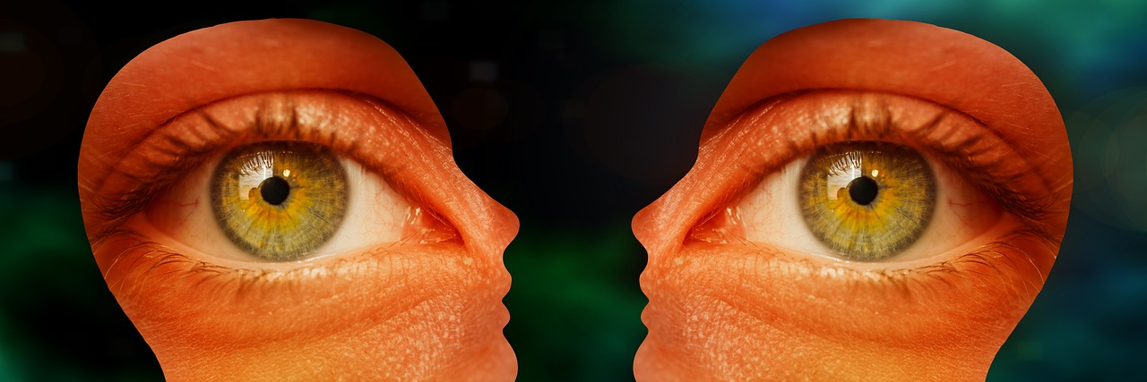
Introduction
Terminology of reflection refers to the cognitive processes of thinking and judgement, which enable us to obtain a more exact understanding of the meaning and dimensions of a specific phenomena, event, or behaviour.
Self-reflection allows us to be more aware of our own way of acting, thinking and feeling and offers us learning about ourselves, learning about others and relationships and offers us many developmental benefits that help us humans to work together more effectively.
Reflection and information disorder are interconnected notions that are relevant to the manner in which information is distributed, consumed, and processed within the context of the contemporary digital era. In recent years, their significance has witnessed a notable increase, particularly in light of the emergence of social media and online platforms.
Source | Pixabay license

Slide 6
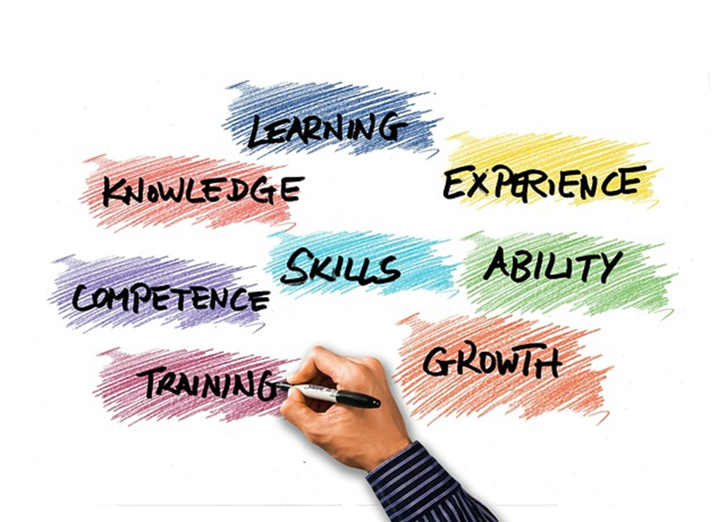
What are Reflective Skills?
Reflective skills encompass a range of cognitive and emotional capacities that enable individuals to engage in critical assessment, evaluation, and successful navigation of information. The acquisition and application of these abilities are of utmost importance for individuals to effectively traverse and comprehend the information landscape, particularly within the realm of information disorder, denoting the dissemination of inaccurate or deceptive information.
Therefore, they play a crucial role in addressing information disorder by fostering a society that is better educated and capable of discernment. The presence of information disorder has the potential to engender a state of perplexity, scepticism, as well as social and political fragmentation, and polarisation.
Source | Pixabay license

Slide 7
Reflective Skills and Information Disorders
When attempting to comprehend any instance of information disorder, it proves advantageous to analyse it through three distinct components::
  Agent. Who were the ‘agents’ that created, produced and distributed the example, and what was their motivation?
  Message. What type of message was it? What format did it take? What were the characteristics?
  Interpreter. When the message was received by someone, how did they interpret the message? What action, if any, did they take?
Source: Pixabay Free Photos

Slide 8

Three Phases of Information Disorders
In this discourse, we posit that it is equally advantageous to contemplate the existence of an exemplification of information disorder as comprising three distinct stages:
The concept of creation. The communication is generated. The concept of production refers to the process of creating goods or services through various inputs and transformations. The communication is transformed into a media artefact.
The concept of distribution refers to the manner in which resources, or services are allocated and spread among individuals, groups, or the communication is disseminated or publicly disclosed.
(Re)Production
When the message
is turned into a
media product
Distribution
When the product is distributed or made public
Creation
When the message
is created
Notes:
Source: Information Disorder: Toward an Interdisciplinary Framework for Research and Policy Making: https://rm.coe.int/information-disorder-toward-an-interdisciplinary-framework-for-researc/168076277c

Slide 9
The Relevance of Refection Skills Addressing Information Disorder
The proficiency in reflection is of great significance when it comes to tackling the issue of information disorder.
In this capacity reflective skills assist both people and society as a whole in countering the dissemination of inaccurate or deceptive information, so making a valuable contribution to fostering a well-informed and unified information environment.
reflective
skills

Slide 10

Consideration of Significant Abilities
Media literacy enables individuals to analyse media content, identify bias, and misinformation, and comprehend the construction and dissemination of media messages.
Critical thinking enables individuals to differentiate between reliable information and misinformation or disinformation.
Individuals should be able to verify the veracity of claims and information using credible sources and fact-checking organisations.
Reflective skills should include the ability to triage information effectively.
Source | Pixabay license

Slide 11
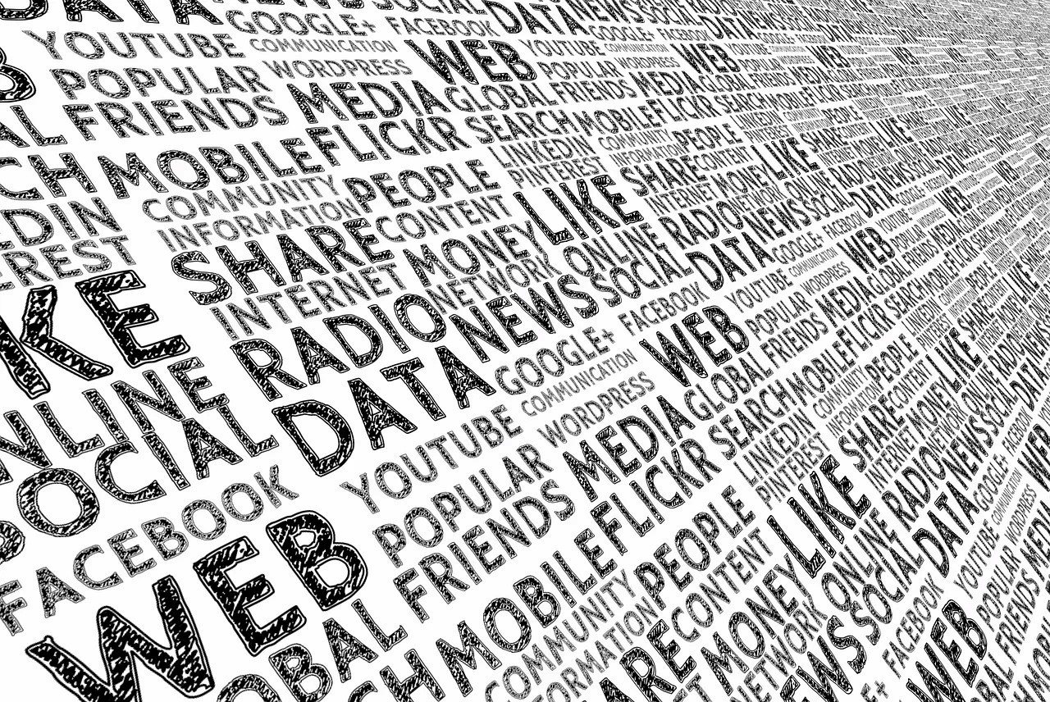
Consideration of Significant Abilities
Evaluating the authenticity and dependability of sources is of paramount importance. The development of reflective abilities encompasses the capacity to discern between sources that are reliable and those that have a track record of disseminating inaccurate or prejudiced information.
A healthy level of scepticism entails scrutinising information and claims, even when they coincide with one's preconceived notions. It is essential to not believe information at face value and to seek evidence to support it.
Cross-referencing information with multiple sources can help individuals get a more accurate picture of a topic and identify discrepancies or inconsistencies in information.
Source | Pixabay license
Notes:
Source: Pixabay Free Photos https://pixabay.com

Slide 12

Consideration of Significant Abilities
The concept of open-mindedness is an important capacity to consider and incorporate diverse viewpoints, as well as the willingness to revise one's opinions in light of new data.
Being digitally literate and understanding digital tools and platforms also includes recognising features and algorithms that can amplify misinformation.
Reflective skills should involve ethical issues, including the exercise of caution in disseminating unverified material, the promotion of responsible information sharing practises, and the avoidance of disseminating misleading or damaging content.
Source | Pixabay license

Slide 13
Some of the Important Reflection Skills
Self-awareness
Active listening
Empathy
Critical thinking
Self-reflection
Emotional regulation
Conflict resolution
Analysis & Syntesis
Evaluation
Source | Pixabay license

Slide 14
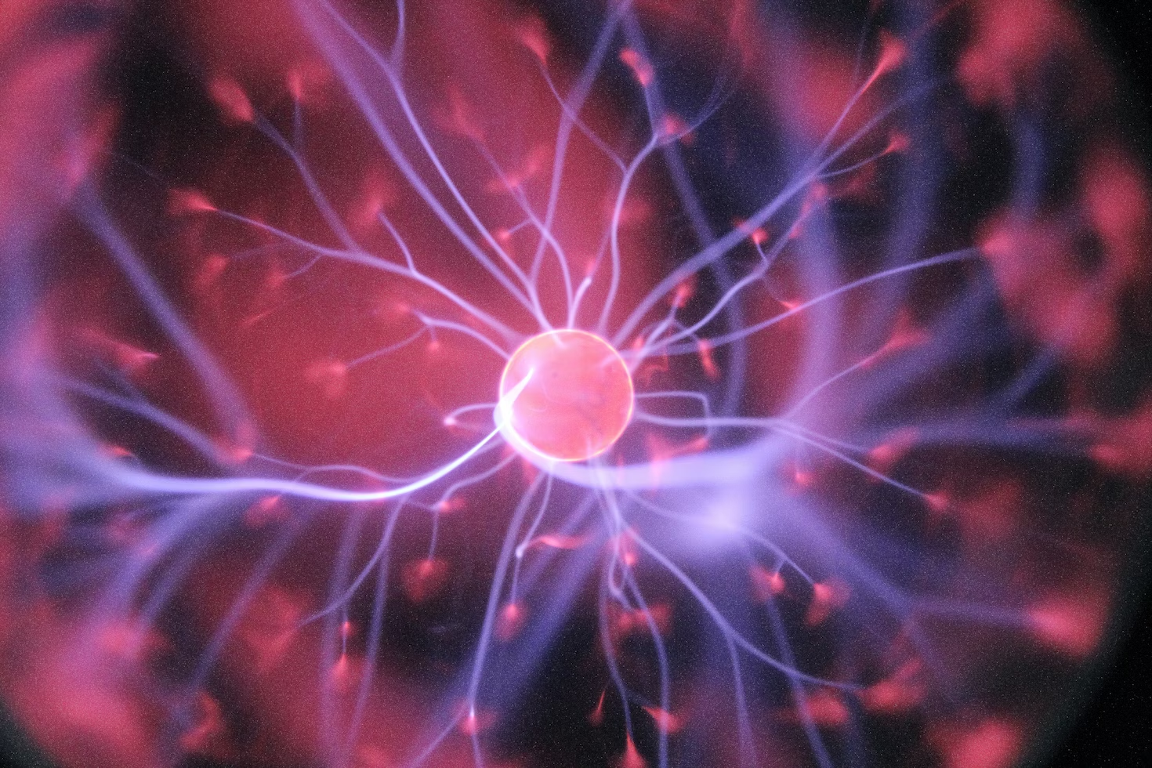
Reflection as a Cognitive process
Reflection is a cognitive process that involves thinking about and analysing experiences, thoughts, and emotions. There are various types of reflection, each serving different purposes and occurring in different contexts. Here are some common types of reflection which we can use to identify misleading and false information or their disorders.
Picture source | Unsplash license
Notes:
Source: Unspelash free Photos https://unsplash.com/

Slide 15
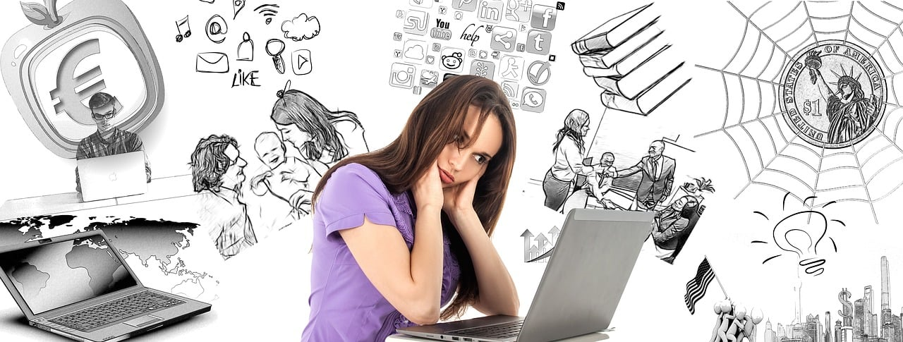
Types of Reflection
Self-reflection involves examining one's own thoughts, feelings, and actions. It is a crucial component of personal growth and self-awareness. Self-reflection can help individuals understand their strengths and weaknesses, identify personal values and beliefs, and make informed decisions.
Critical reflection goes beyond self-examination and involves analysing and evaluating experiences, ideas, or situations in a critical and objective manner. It often requires questioning assumptions, challenging existing beliefs, and seeking alternative perspectives.
Source | Pixabay license
Notes:
Source: Pixabax Free Photos https://pixabay.com

Slide 16
Types of Reflection
Ethical reflection focuses on moral and ethical dilemmas. It involves considering the ethical implications of one's actions, decisions, or beliefs and aligning them with personal or societal values.
Cultural reflection involves exploring and understanding one's cultural identity, biases, and how culture influences one's perspectives and behaviors. It can be a valuable tool for fostering cultural awareness and sensitivity.
Experiential reflection is based on learning from direct experiences. It involves analysing what was learned, how it was learned, and how the knowledge gained can be applied in the future.
Group reflection occurs when a team or a group of people collectively analyse their experiences or the outcomes of a project or task. It can lead to better teamwork, improved decision-making, and enhanced problem-solving.

Slide 17
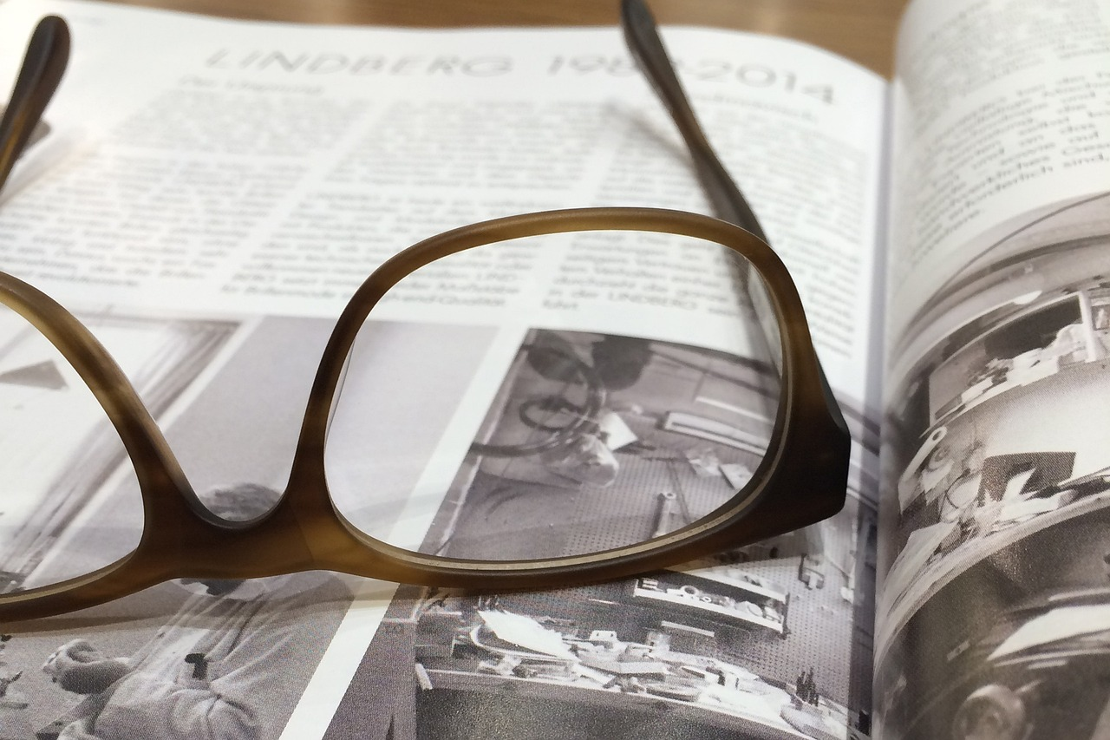
Types of Reflection
Metacognition is a higher-order form of reflection that involves thinking about one's own thinking processes. It helps individuals become more aware of their cognitive strengths and weaknesses, leading to improved learning and problem-solving skills.
These types of reflection are not mutually exclusive, and individuals often engage in multiple forms of reflection depending on the situation and their purpose.
Reflection is a valuable tool for personal and professional development, as it encourages introspection, critical thinking, and continuous learning.
Source | Pixabay license

Slide 18

Summarising in the Process of Reflection
Reflection skills play an important role in the process of summarising in the following sequential steps:
Understanding the Material: Before you can create an effective summary, you need to understand the material thoroughly. Reflective skills involve the ability to critically analyse and comprehend the information presented in the source material.
Source | Pixabay license
Notes:
Source: Unsplash Free Photos https://unsplash.com/

Slide 19
Summarising in the Process of Reflection
Identifying Key Points: Reflective skills help you identify the main ideas, key arguments, and significant details within the content. This discernment is crucial for creating a meaningful summary.
Evaluating Relevance: Reflective thinking allows you to assess the importance and relevance of various elements within the text. You can determine which information should be included in the summary and which can be omitted.
Notes:
Source: Pixabay Free Photos https://pixabay.com

Slide 20

Summarising in the Process of Reflection
Organising Information: Reflective skills help you organise the information logically and coherently in your summary. You can structure the summary to convey the main points effectively.
Source | Pixabay license
Notes:
Source: Pixabay Free Photos https://pixabay.com

Slide 21
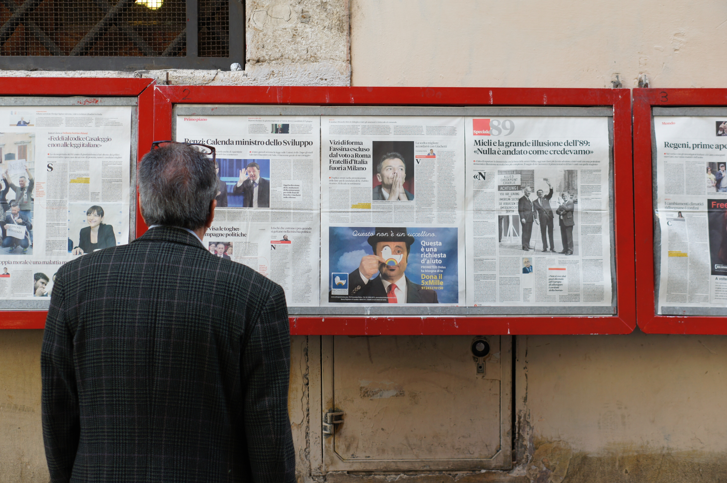
Summarising in the Process of Reflection
Avoiding Bias: Reflective skills enable you to avoid introducing your personal biases or opinions into the summary. A good summary should be objective and faithful to the original content.
Critical Analysis: Reflective skills also involve critically evaluating the source material, including its strengths, weaknesses, and any potential biases or flaws. This analysis can influence the way you summarise and present the information.
Synthesising Information: Summarising often requires synthesising information from multiple sources or sections of a text. Reflective skills aid in synthesising diverse information into a coherent summary.
Picture source | Unsplash license

Slide 22
An Example of a Summary
Media Text
Title: "Climate Change and Its Impact on Coastal Cities"
Description: A news article published on September 15, 2023, discusses the growing concern of climate change and its effects on coastal cities. It highlights the increasing frequency of extreme weather events, rising sea levels, and the need for urgent action to mitigate these impacts.
Summary
The article, titled "Climate Change and Its Impact on Coastal Cities," published on September 15, 2023, focuses on the escalating threat of climate change to coastal cities. It emphasises the growing occurrence of severe weather events and the rising sea levels that are endangering these areas. The article underscores the pressing need for immediate measures to address and alleviate these consequences.

Slide 23
Paraphrasing in the Process of Reflection
Clarification
helps clarify complex statements
Active listening
trying to grasp the message
Confirmation
helps confirm that you've accurately understood the message
Engagement
interested about the message conveyed
Paraphrasing is a specific form of reflective skill that involves restating someone's words or ideas in your own words. In communication It serves several purposes.
Effective paraphrasing involves using your own words while preserving the core message and intent of the original statement. It's a valuable skill in both professional and personal interactions.
It promotes understanding and rapport, making it particulary valuable in any context where clear communication is important .

Slide 24
An Example of Paraphrasing
Original media text
"The groundbreaking discovery of a new species of dinosaur has captured the attention of scientists worldwide."
Paraphrased version
"The attention of scientists worldwide has been drawn to a remarkable find in the field of paleontology: the groundbreaking identification of a previously unknown dinosaur species."
Note:
*This summary provides a brief overview of the media text, capturing its main points and key information. Depending on the context and purpose of your summarisation, you can adjust the level of detail and length of the summary accordingly.
*Paraphrasing involves rephrasing the original text while preserving its meaning and conveying the information in a different way.

Slide 25
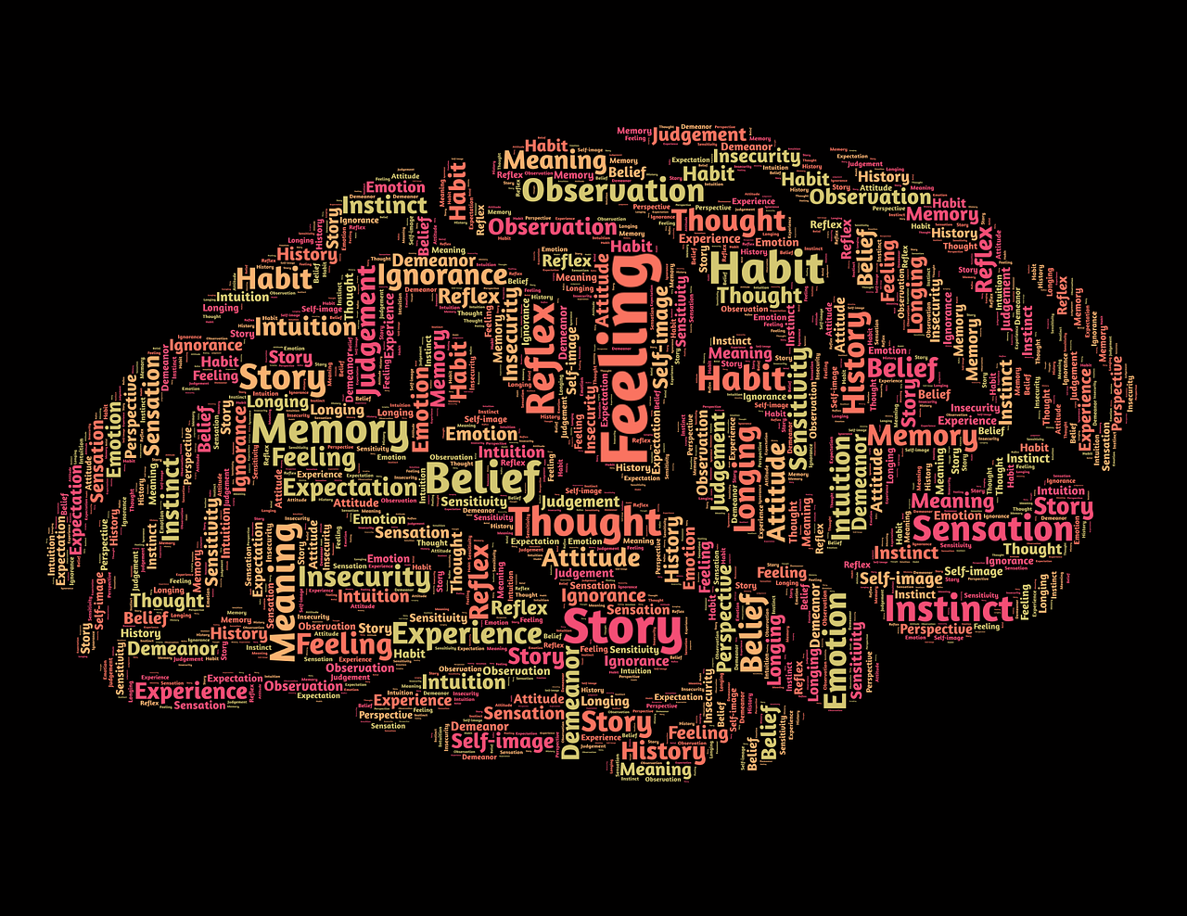
Reflective Practice
The Gibbs Reflective Cycle (GRC) is a structured approach to reflection that is commonly used in education to help individuals ponder critically on their experiences and derive knowledge from them. It was created by Graham Gibbs and is commonly used for reflective writing and self-evaluation.
The cycle consists of six stages through which individuals can analyse their experiences and obtain insights.
The Gibbs Reflective Cycle is an effective instrument for fostering self-awareness, critical reasoning, and personal growth. It encourages people to reflect on their experiences, evaluate their reactions and emotions, and devise a structured plan for growth.
Source | Pixabay license
Notes:
Source: Pixabay Licence (Rree Photos): https://pixabay.com

Slide 26
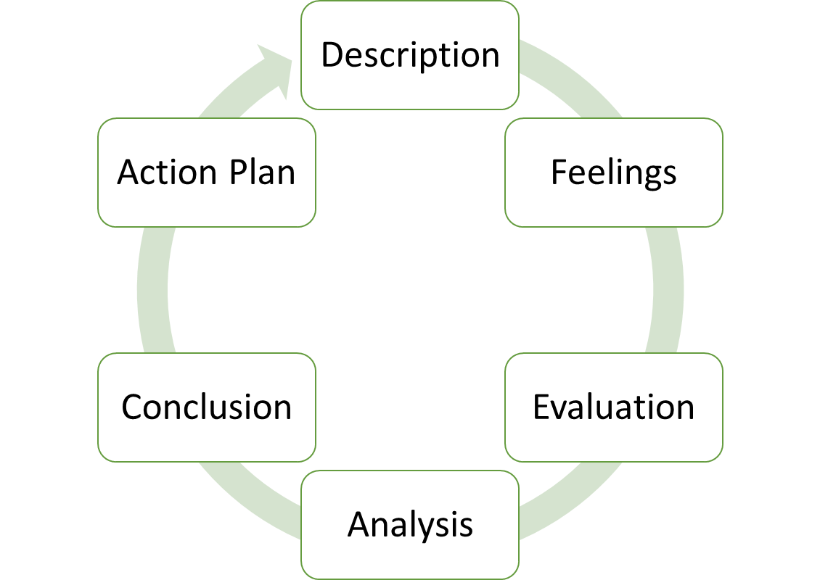
Six Stages of Gibbs Reflective Cycle
Description –Describe the event or experience you are reflecting on.
Feelings - Explore your emotions and feelings at the time of the event.
Evaluation – Evaluate the positive and negative aspects of the situation. What is well what can be improved.
Analysis – analyse deeply. Consider what you learned from the experience.
Conclusion – draw conclusions about the experience. What could have been done differently? What would you do if you encountered a similar situation in the future?
Action Plan – create an action plan for the future. What changes will you make, and how will you apply what you've learned from this reflection?

Slide 27
Gibbs Reflective Cycle in Practice
Scenario: You are a concerned citizen who came across a media article claiming that a new study shows that a popular childhood vaccine causes autism. The article has gone viral on social media, and you are unsure about its credibility.
1. Description:
Describe the situation and the article: The article claims that a new study links a childhood vaccine to autism and has been widely shared on social media.
2. Feelings:
Express your initial emotions: You feel concerned and anxious about the potential harm this information can cause if it is false. You're also curious and want to know the truth.
3. Evaluation:
Assess the situation: You understand the importance of vaccines in public health and the potential consequences of misinformation.
Recognise the need for fact-checking: You acknowledge the need to verify the information's credibility.

Slide 28
Gibbs Reflective Cycle in Practice
4. Analysis:
Analyse the situation in-depth:
  Identify potential sources of information disorder: The sensationalist nature of the article and the lack of reputable sources raise concerns.
  Explore biases and motivations: Consider the possibility of the article being politically or financially motivated.
  Think about the implications: Recognise that such misinformation can erode trust in vaccines and public health efforts.
5. Conclusion:
Sum up what you have learned from the analysis:
  The article's credibility is questionable, given its sensationalism and lack of reputable sources.
  Motivations behind this misinformation need further investigation.
  The potential consequences are severe, including reduced vaccination rates and public health risks.

Slide 29
Gibbs Reflective Cycle in Practice
6. Action Plan
Outline steps to address the situation:
  Conduct a thorough fact-check: Research the claims and seek information from credible sources.
  Share reliable information: If the article is indeed misleading, share accurate information from authoritative sources to counteract the misinformation.
  Engage with the author or publisher: If possible, question the credibility of the article and ask for their sources.
  Report the misinformation: Use social media reporting tools to flag the misleading article.
  Promote media literacy: Encourage critical thinking and media literacy in your social network to prevent the spread of such information disorder.
By applying Gibbs Reflective Cycle, you can navigate the situation with a systematic approach, promoting critical thinking and responsible information sharing in an era where misinformation is rampant.

Slide 30
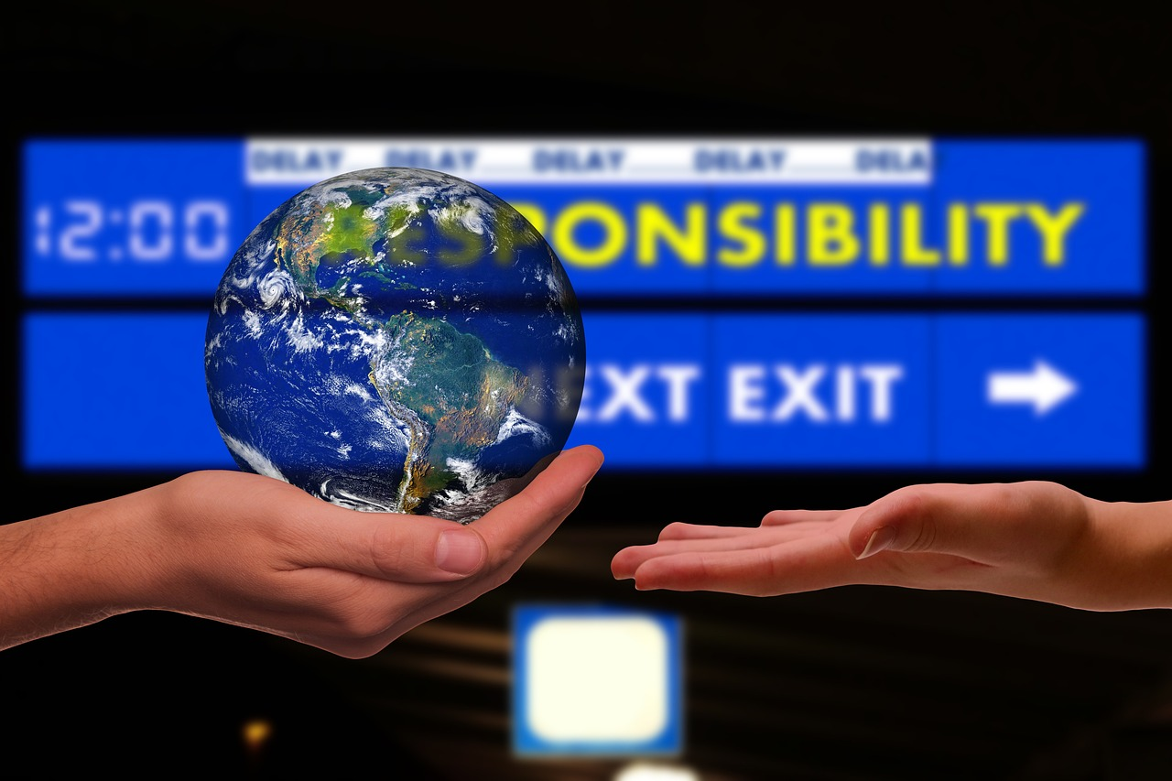
Gibbs Reflective Cycle in Practice
By applying Gibbs Reflective Cycle, you can navigate the situation with a systematic approach, promoting critical thinking and responsible information sharing in an era where misinformation is rampant.
Source | Pixabay license
Notes:
Source: Pixabay Free Photos https://pixabay.com

Slide 31
References and further reading
Altman, D. (2014). The Mindfulness Toolbox. Eau Claire, WI: PESI Publishing & Media, Inc.
Carrel, S.E. (2001). The Therapist Toolbox. Thousand Oaks, California: Sage Publications, Inc.
ECU Edith Cowan: Curriculum design: Reflective Learning. Retrieved from: https://intranet.ecu.edu.au/learning/curriculum-design/teaching-strategies/reflective-learning (September, 2023)
Kassinove. H. (2013). Anger Disorders. New York: Routledge, Taylor & Francis Group.
Poumpouras, Evy. (2020). Becoming Bulletproof. London: Icon Books Ltd.
Science Direct, Volume25, Issue 5.May 2021. The Psychology of Fake News: Reasoning. Retrieved from: https://www.sciencedirect.com/science/article/pii/S1364661321000516 (September, 2023).
Skills You Need, Helping you decelop life skills. Interpersonal Skills. Retrieved from: https://www.skillsyouneed.com/interpersonal-skills.html (Sepetmber, 2023).
University of Edinburgh. Reflection Toolkit. Retrieved from: https://www.ed.ac.uk/reflection/reflectors-toolkit/reflecting-on-experience (September, 2023)

Slide 32
References and further reading
University of Reading: Practice-based and reflective learning. Retrieved from: https://libguides.reading.ac.uk/reflective/thinking (September, 2023).
Wardle, C., Derakhshan, H. (2017). Information Disorder , Toward an interdisciplinary framework for research and policy making. Strasboutg: Council of Europe F-67075.

Slide 33
Congratulations!
You have completed this part
Funded by the European Union. Views and opinions expressed are however those of the author(s) only and do not necessarily reflect those of the European Union or the European Education and Culture Executive Agency (EACEA). Neither the European Union nor EACEA can be held responsible for them.

