Slide 1



https://www.costaid.eu
Module 7 Digital skills
Funded by the European Union. Views and opinions expressed are however those of the author(s) only and do not necessarily reflect those of the European Union or the European Education and Culture Executive Agency (EACEA). Neither the European Union nor EACEA can be held responsible for them.

Slide 2


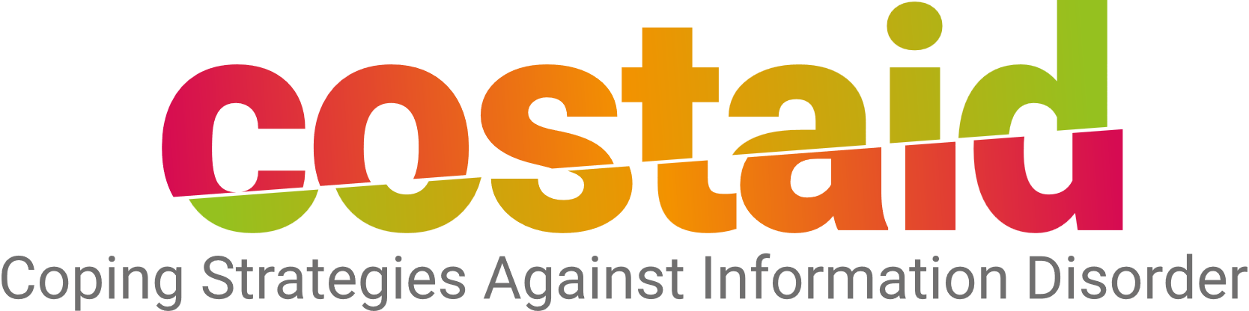

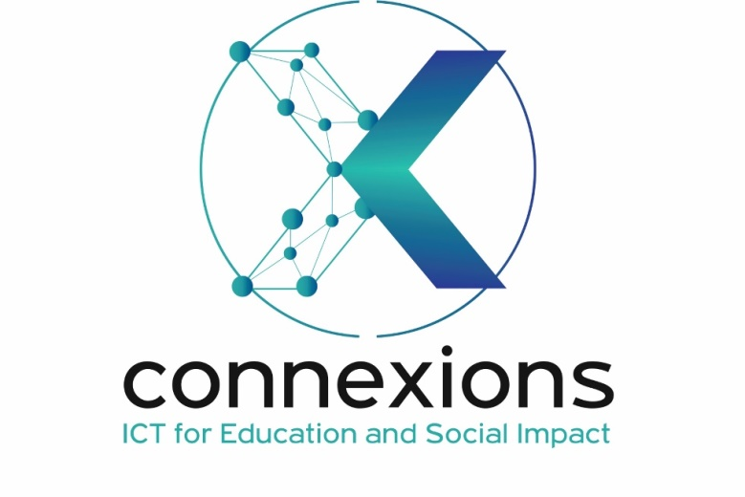


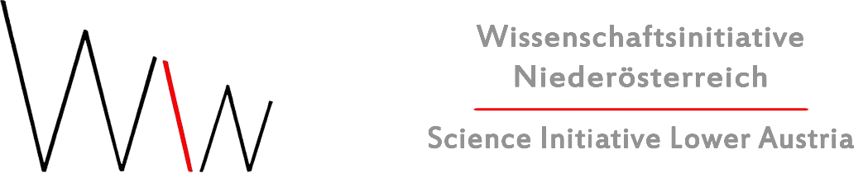
Partners

Slide 3
Modules
4. Enabling dialogue
5. Ethics
6. Reflective skills
7. Digital skills
1. Awareness
2. Critical thinking
3. Conflict solving

Slide 4

Objectives
Which digital skills are needed to identify fake news and hoaxes
The role of social media in the distribution of fake news
How one can assess the credibility of news sources
How one can verify the authenticity of images and videos

Slide 5

Why are digital skills necessary?
Media literacy and digital skills are important competencies for the 21st century. They help us to access, analyse, evaluate, create and communicate with various forms of media and technology.
Media literacy and digital skills equip us with the skills to navigate the information landscape effectively. In an era of fake news and hoaxes, being media literate means knowing how to discern credible sources, fact-check information, and critically analyse content. It empowers us to make informed decisions, promotes responsible digital citizenship, and safeguards against misinformation. Media literacy is a cornerstone of digital literacy, enabling us to engage with the digital world with confidence and discernment
Picture source | Unsplash license

Slide 6

Why are digital skills needed to identify fake news and hoaxes?
Digital skills are the abilities to use digital devices, communication tools, and networks to access and manage information. They are essential for participating in the modern society, as we are constantly exposed to various sources of information online. However, not all information is reliable or trustworthy. Fake news and hoaxes are deliberate attempts to mislead, manipulate, or deceive people with false or inaccurate information. They can have negative impacts on individuals and society, such as spreading fear, hatred, or confusion, influencing opinions and behaviours, or undermining trust in institutions and democracy.
Therefore, digital skills are needed to identify fake news and hoaxes, and to protect ourselves from being influenced or harmed by them.
Picture source | Unsplash license

Slide 7

Which digital skills are needed to identify fake news and hoaxes?
Some of the digital skills that can help us are:
Media literacy: This is the ability to understand and use different forms of media, such as texts, images, videos, or audio. Media literacy can help us interpret the messages and meanings of the media content we consume, and to identify the techniques and strategies used to create and distribute them.
Information literacy: This is the ability to find, select, use, and communicate information effectively and ethically. Information literacy can help us locate relevant and reliable sources of information, and to compare and contrast different perspectives and evidence.
Digital citizenship: This is the ability to behave responsibly, respectfully, and safely online. Digital citizenship can help us respect the rights and privacy of others, avoid cyberbullying and hate speech, and report or flag inappropriate or harmful content.
Picture source | Unsplash license

Slide 8
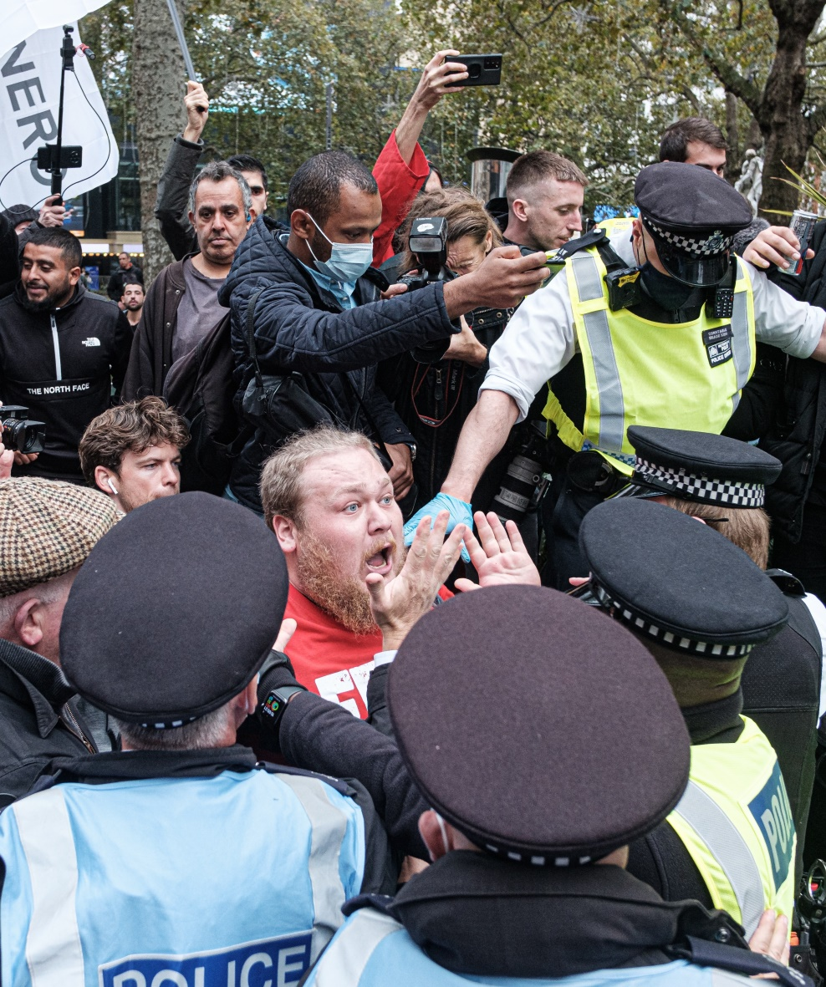
Social media and fake news
Social media platforms, such as Facebook, Twitter, and Instagram, are often used as channels for disseminating fake news, as they allow users to easily share and access information from various sources.
An important factor that contributes to the role of social media in spreading fake news is the lack of regulation and verification of the information posted on these platforms. Unlike traditional media outlets, such as newspapers or television channels, which have editorial standards and fact-checking processes, social media platforms do not have the same level of accountability or responsibility for the content they host.
This allows anyone to create and share fake news without being detected or punished. Moreover, some artificial intelligence techniques, such as machine learning and deep learning, can be used to generate and manipulate fake content, such as images, videos, or text, that can deceive people and make them believe that they are real.
Picture source | Unsplash license

Slide 9

Factors contributing to the rapid spread of fake news online
Social Media Platforms: The widespread use of social media allows fake news to be quickly shared, reaching a large audience within moments.
Confirmation Bias: People tend to believe and share information that aligns with their existing beliefs, making them susceptible to fake news that confirms their biases.
Echo Chambers: Online communities or echo chambers reinforce individuals' beliefs by exposing them to like-minded content, further promoting the spread of fake news within these closed circles.
Lack of Media Literacy: Many individuals lack the critical thinking skills needed to discern reliable sources from unreliable ones, making them more susceptible to fake news.
Picture source | Unsplash license

Slide 10
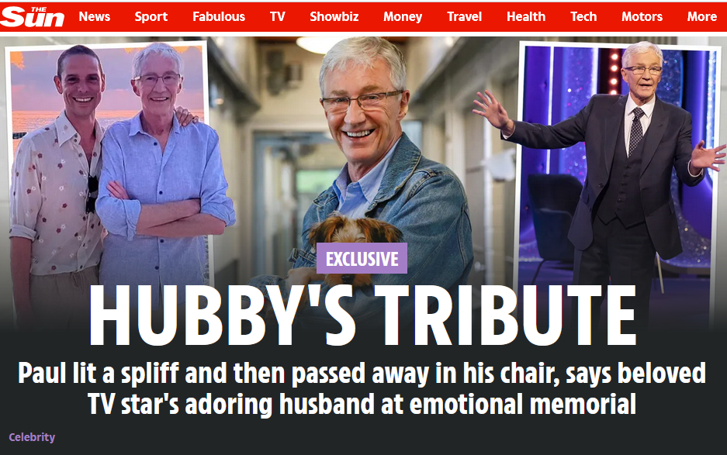
Factors contributing to the rapid spread of fake news online
Emotional Appeal: Fake news often employs emotional language or sensationalism, evoking strong reactions that encourage sharing.
Algorithmic Bias: Social media algorithms may prioritise engaging or controversial content, inadvertently promoting fake news to maximise user engagement.
Ease of Creation: Creating and sharing content online is simple, enabling anyone to produce and disseminate fake news.
Clickbait Headlines: Catchy, misleading headlines encourage clicks and shares, even if the content is false.
Influence Campaigns: State and non-state actors may use coordinated efforts to spread fake news for political or ideological purposes.
Picture source thesun.co.uk

Slide 11
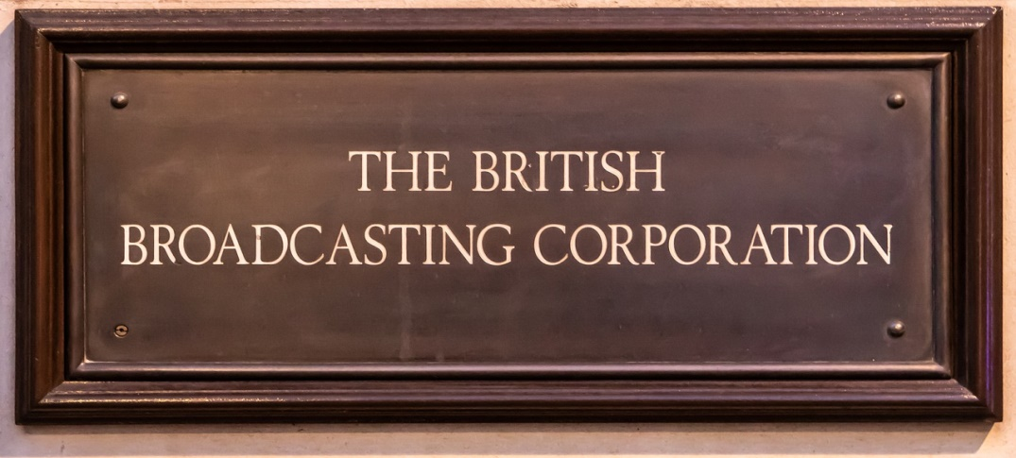
What can you do to assess the credibility of news sources?
Check the Source's Reputation:
Look for well-known, respected news organisations such as BBC, Reuters, The New York Times, or NPR. These sources often have established reputations for journalistic integrity.
Examine the About Page:
Visit the news source's "About" or "About Us" page. Legitimate news outlets provide information about their history, mission, and editorial standards.
Avoid Social Media as the Sole Source:
News shared on social media platforms can be unreliable. If you find a story on social media, try to trace it back to a credible news source for verification.
Picture source | Pixabay License

Slide 12
Credibility checks: The CRAAP test
This test is used to evaluate sources of information and determine their credibility. It benefits students and researchers who need to evaluate sources for academic purposes.
Currency: Timeliness of the information and whether it is up-to-date and relevant to the topic at hand.
Relevance: Refers to the degree to which the information is related to the research question or topic being investigated.
Authority: Credibility of the source and whether it is a reliable source of information.
Accuracy: The factual correctness of the information provided and whether it can be verified through other sources.
Purpose: The reason the information exists and whether it is intended to inform, persuade, entertain, or deceive.

Slide 13
Credibility checks: SMART Check
The SMART Check stands for Source, Motive, Authority, Review, and Two-Source Test. This test is particularly useful for evaluating online sources, such as news articles or social media posts.
Source: Refers to the origin of the information, including who created it, and their affiliations and biases.
Motive: The reason why the information was created and whether there is a specific agenda or bias behind it.
Authority: The credibility of the source and whether it is a reputable source of information.
Review: Refers to the quality of the information, including whether it has been reviewed by experts or fact-checkers.
Two-Source Test: The practice of verifying information by cross-referencing it with at least two reputable sources.

Slide 14
Credibility checks: The 5 “W” Questions (1/2)
The 5Ws test is a method of gathering information by asking five key questions: who, what, when, where, and why. These questions are typically used by journalists and investigators to get a complete picture of a situation and to ensure that all relevant information has been gathered.
Who is the author? – The individual or organisation responsible for creating the content. Knowing the author can provide insight into their perspective and expertise, which can affect the credibility of the information.
What is the content’s purpose? – The reason for creating the content, whether it is to inform, persuade, entertain, or something else. Understanding the purpose can help to determine the bias and relevance of the information.

Slide 15
Credibility checks: The 5 “W” Questions (2/2)
When was it published? – Refers to the date the content was released. Knowing the publication date can help to determine the timeliness and relevance of the information.
Where is the content from? – The source of the content, whether it is a reputable news organisation, personal blog, or social media platform. Understanding the source can help to determine the credibility and bias of the information.
Why does the information exist? – The reason why the information was created and published. Knowing the motivation behind the information can help to determine the bias and reliability of the content.

Slide 16
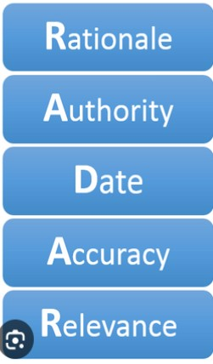
Credibility checks: RADAR Method (1/2)
The RADAR test is a method of evaluating information from online sources for reliability and credibility. It stands for Rationale, Authority, Date, Accuracy, and Relevance.
Rationale: The reason why the information exists and the purpose of the content. Knowing the rationale behind the information can help to determine whether it is biased or objective.
Authority: The credentials and expertise of the author or publisher of the information. Understanding the authority of the source can help to determine whether the information is trustworthy and reliable.

Slide 17
Credibility checks: RADAR Method (2/2)
Date: The time when the information was published or updated. Knowing the date can help to determine whether the information is still relevant and up-to-date.
Accuracy: Refers to the truthfulness and correctness of the information. Checking for accuracy involves verifying the information with multiple sources and evaluating the evidence presented.
Relevance: How well the information relates to the topic or question at hand. Evaluating relevance involves considering whether the information is useful and applicable to the specific situation.

Slide 18
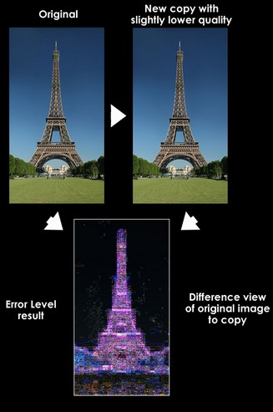
How can you verify the authenticity of images and videos?
Source Cross-Checking: Verify the source by comparing the image or video with trusted sources or eyewitness accounts!
Image Forensics Software: Utilise image forensics tools to detect signs of manipulation, such as altered pixels or digital artefacts!
Contextual Clues: Investigate the context surrounding the image or video, including captions, timestamps, and related content!
Eyewitness Testimony: Seek out eyewitness accounts or statements from credible sources to confirm or debunk the content!
Picture source: Forensics.map-base.info

Slide 19
Free image checking tools (picture upload)
Image forensics software are tools that can help you analyse and verify the authenticity and integrity of digital images. They can help you detect if an image has been edited, manipulated, or tampered with. Here are some free image forensics software that you can use:
Forensically: This is a web-based tool that offers a set of features for digital image forensics, such as clone detection, error level analysis, noise analysis, metadata extraction, geotagging, thumbnail analysis, JPEG analysis, and more. It is possible to upload an image or paste an image URL to use this tool. It has an interesting tutorial to show how to use the software.
https://29a.ch/photo-forensics/
TinEye: This is a web-based tool that allows you to perform reverse image search. It can help you find out where an image came from, how it is used, if modified versions of it exist, or to find higher resolution versions. You can upload an image or paste an image URL to use this tool.
https://tineye.com/

Slide 20
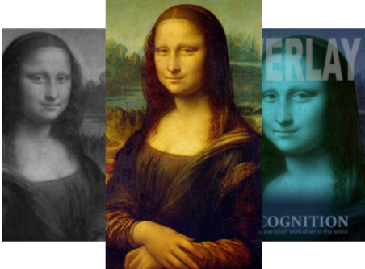
Free image checking tools (picture upload)
Google Reverse Image Search: This feature allows you to search by image or perform a reverse image search. It can help you find out where an image came from, how it is used, if modified versions of it exist, or to find higher resolution versions.
https://images.google.com
Picture source: tineye.com

Slide 21
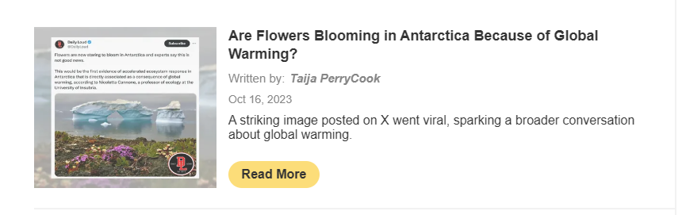
Free image checking tools (software download)
The Internet provides a great number of software tools for image checking. Some of them offer free versions.
JPEGsnoop: This is a Windows-based tool that can reveal hidden information in JPEG images, such as the camera make and model, quality settings, editing software used, EXIF data, quantisation tables, Huffman tables, and more. It can also detect if an image has been recompressed or modified by Photoshop.
https://jpegsnoop.updatestar.com/

Slide 22
Free image checking tools (software download)
Ghiro: This is an open source tool that automates the process of digital image forensics. It can analyse a massive amount of images and provide reports on various aspects, such as metadata, GPS location, thumbnails, error level analysis, principal component analysis, string extraction, and more. 8
https://www.getghiro.org/
Amped Authenticate: This is a professional tool that can perform advanced image authentication and tamper detection. It can analyse various aspects of an image, such as format, metadata, source identification, content integrity, color filter array analysis, camera ballistics, and more. It offers a free trial version for evaluation purposes.
https://ampedsoftware.com/authenticate

Slide 23
References and further reading
Journalism, fake news & disinformation: Handbook for journalism education and training. UNESCO 2018, ISBN: 978-92-3-100281-6
Gerorge Krasadakis: Fake News and Misinformation: How digital tech can help. Retrieved from: https://www.theinnovationmode.com/the-innovation-blog/misinformation-online-a-solution-powered-by-state-of-the-art-tech
Council of Europe: Dealing with propaganda, misinformation and fake news. Retrieved from: https://www.coe.int/en/web/campaign-free-to-speak-safe-to-learn/dealing-with-propaganda-misinformation-and-fake-news
European Commission: Tackling online disinformation. Retrieved from https://digital-strategy.ec.europa.eu/en/policies/online-disinformation
Matt Burns: A quick guide to digital image forensics. Retrieved from: https://www.cameraforensics.com/blog/2020/03/06/a-quick-guide-to-digital-image-forensics-in-2020/

Slide 24
Congratulations!
You have completed this part
Funded by the European Union. Views and opinions expressed are however those of the author(s) only and do not necessarily reflect those of the European Union or the European Education and Culture Executive Agency (EACEA). Neither the European Union nor EACEA can be held responsible for them.

