Slide 1



https://www.costaid.eu
Module 3 Conflict Solving
Funded by the European Union. Views and opinions expressed are however those of the author(s) only and do not necessarily reflect those of the European Union or the European Education and Culture Executive Agency (EACEA). Neither the European Union nor EACEA can be held responsible for them.

Slide 2


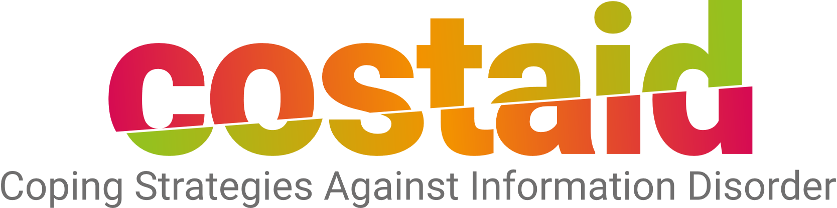

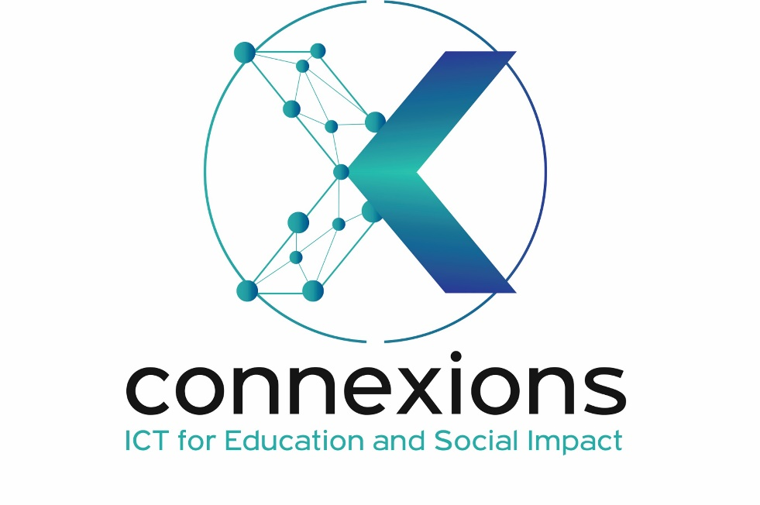

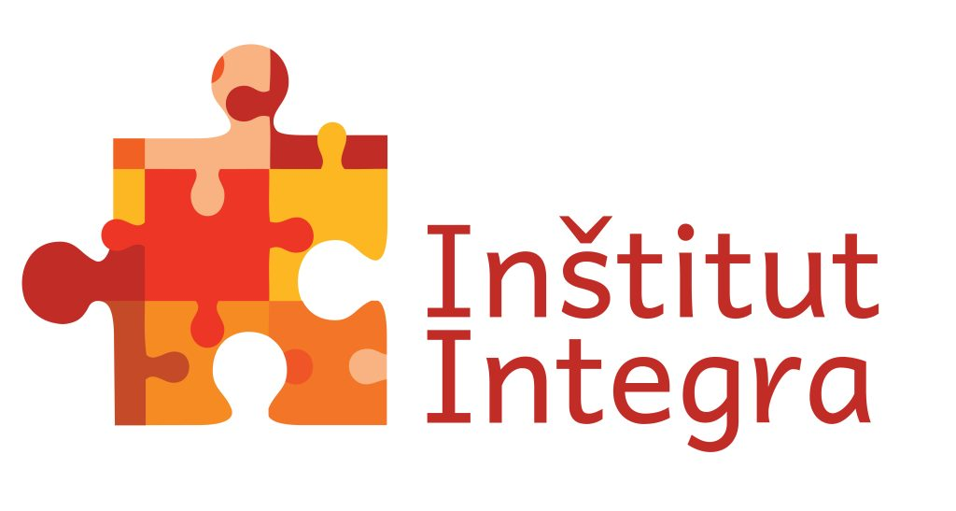

Partners

Slide 3
Modules
4. Enabling dialogue
5. Ethics
6. Reflective skills
7. Digital skills
1. Awareness
3. Conflict Solving
2. Critical Thinking

Slide 4

Objectives
To raise awareness on the liaison between information disorder and conflicts
To foster comprehension on the essence and causes of conflicts
To explain the methods and techniques for conflict resolution
To build skills on conflict resolution and living together

Slide 5
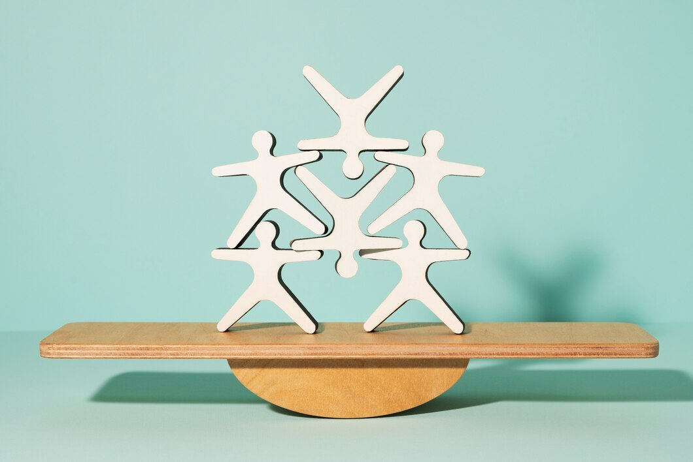
Living Together and Conflict Solving
Living Together in communities and groups involves the creation of create an environment where individuals can express themselves, understand each other, maintain respect, prevent major disputes, collaborate effectively, and, ultimately, live together in harmony. This is achieved via cultivation of open communication, respect of diversity, empathy, collective problem-solving, shared responsibilities, efficient management of conflicts and so on.
Conflict-solving skills are the cornerstone of harmonious co-existence and successful living together.
By mastering these skills, people can navigate the complexities of shared spaces (in living, education, work) and build positive, supportive relationships with their peers, family, co-workers, etc.
Image by Freepik

Slide 6
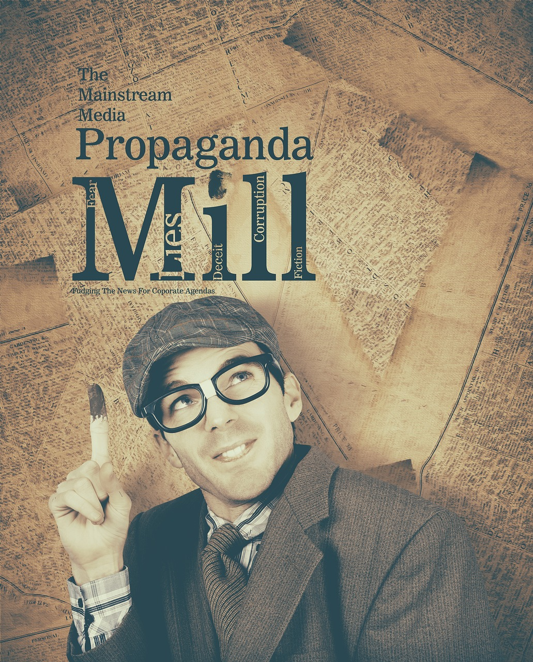
Information Disorder and Conflicts
Information disorder by definition obstructs harmonious co-existence in communities and groups.
Information disorder triggers conflicts among individuals and groups. It attacks the bottom line of co-existence by creating and reinforcing feelings of mistrust, fear, exclusion and hostility toward perceived external and internal opponents.
Managing and solving conflicts caused by information disorder is main task for modern societies in all areas of life.
Promoting accurate information, fostering strong conflict resolution skills, and cultivating a sense of empathy and understanding are vital components of living together harmoniously. Addressing information disorder is crucial for promoting constructive dialogue and understanding, which, in turn, can contribute to more effective conflict resolution and harmonious living.
However, when information disorder is in place, proper understudying and managing conflicts can outweigh the negative effects and bring back balance in group dynamics
Source | Pixabay license

Slide 7

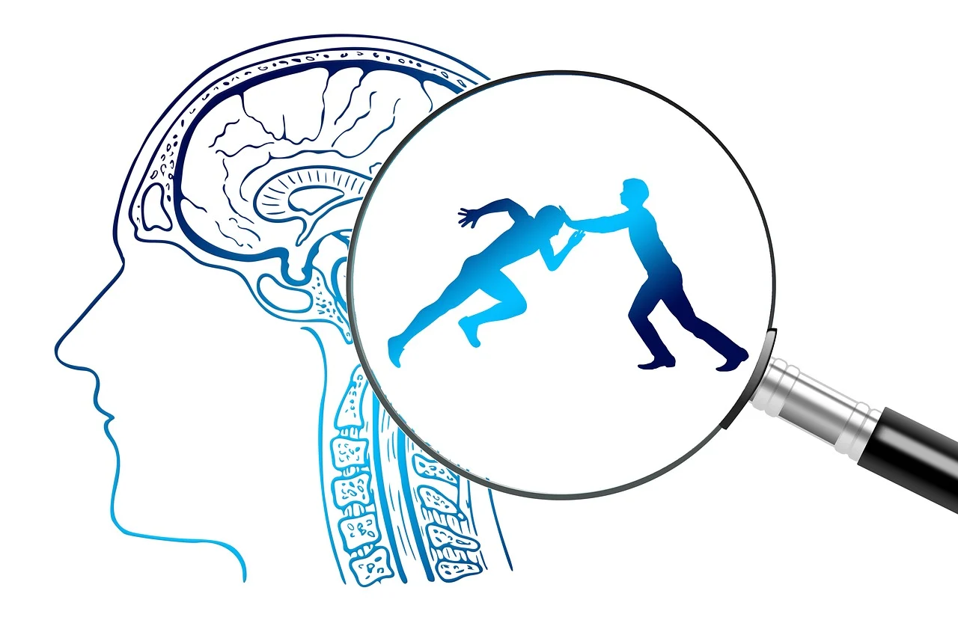
What is a Conflict?
Conflict
is a serious disagreement about something important for an individual or a group of individuals.
The term comes from the Latin word conflictus meaning “clash” or “collision”
click
Whenever two or more people have different interests, values, goals, and understanding conflict arises.
A conflict
Refers to all kinds of opposition or antagonistic interaction between or among individuals and groups
Arises from differences in perceptions, interpretations, and judgments about a situation
Results from a person's perception that there are incompatibilities or differences between one's own goals, values, or beliefs and those of others
Exists whenever one party perceives that another party has hampered or is about to hamper, the accomplishment of goals
Source | Pixabay license

Slide 8
Types of Conflict
Organi- sational
Economic
Political
Ideological
Cultural
Conflict types based on
Minor Armed
Non-violent
Major armed
War
Use of violence
Context
Conflict Parties
Consequences
Display
Motivation/Needs
International
Intersociety
Intergroup
Intrapersonal
Intragroup
Interpersonal
Cultural
(Values, Ideas, Principles)
Material
(Resources)
Social Needs (Status, Role, Power)
De-
structive
Con-structive
Latent
Manifest
Source | T-Kit 12: Youth transforming conflict (2012), Council of Europe

Slide 9
Actors in Conflict
Intrapersonal
Interpersonal
Intragroup
Intergroup
Intrapersonal Conflict: Conflict within an individual's own thoughts and emotions. This might involve inner struggles over decisions, values, or conflicting goals.
Interpersonal Conflict: Conflict between individuals due to differences in personalities, communication styles, interests, or values. These conflicts often arise from misunderstandings or clashes in personal relationships.
Intragroup Conflict: Conflict that occurs within a single group or team, such as among members of a family, classmates in school, colleagues in a workplace, or members of a community organisation.
Intergroup Conflict: Conflict that arises between different groups or teams, often stemming from competition for resources, power, or status. This could include conflicts between ethnic, religious, or social groups.

Slide 10
Causes of conflicts
Conflicts in a group can arise from a variety of sources, often due to differences in opinions, interests, values, and other factors. Here are some common causes of conflicts in a group setting:
Personal Differences – personal traits and emotions are common sources of conflict
Misunderstanding - when group members do not understand their tasks, roles, rights and responsibilities within a group or do not interpret information objectively
Information Deficiency – is very much linked with misunderstanding. Inadequate information sharing or unclear messages can create confusion and frustration.
Poor Communication – Ambiguity, vagueness of statement, omission of critical points may result in confusion and formation of twisted opinions that lead to conflict
Goal Differences - when group members have varying ideas about what the group should achieve or how goals should be prioritised, conflicts can arise over which direction to take

Slide 11
How to approach conflicts in a group?
Traditional Approach | Modern Approach
Conflict is bad for the group | Conflict may have a positive effect on the group
Conflict is avoidable | Conflict is unavoidable
Conflict is caused by poor communication, lack of openness and trust within the group and failure to respond to the needs of the group members | Conflict is a natural occurrence in groups as individuals come with different values, beliefs, goals, perceptions. They could also arise from group structure, internal authority levels and so on.
Group leaders must avoid or suppress conflicts by eliminating the causes | Group leaders must manage conflicts: either solve it by considering all parties’ interests or even stimulate functional conflicts to keep the group viable, self-critical and creative
Optimal group performance does not allow for conflict | Moderate level of conflict enhance group performance
The best way to deal with conflicts is to avoid them. | The best way to deal with conflicts is to manage and/or solve them.

Slide 12
Conflict process
Stage 1
Potential Opposition, Incompatibility
Stage 2
Recognition
Stage 3
Intention/Goals
Stage 4
Behaviour
Stage 5
Consequences
Previous conditions:
Communication
Structure
Personal variables
Approach intentions (Conflict solving methods):
Avoidance
Collaboration
Competition
Compromise
Adjustment
Open conflict:
The parties’ behavior
The other’ reactions
Perceived Conflict
Superior Performance
Felt Conflict
Diminished Performance
Source | Adapted from https://theintactone.com

Slide 13
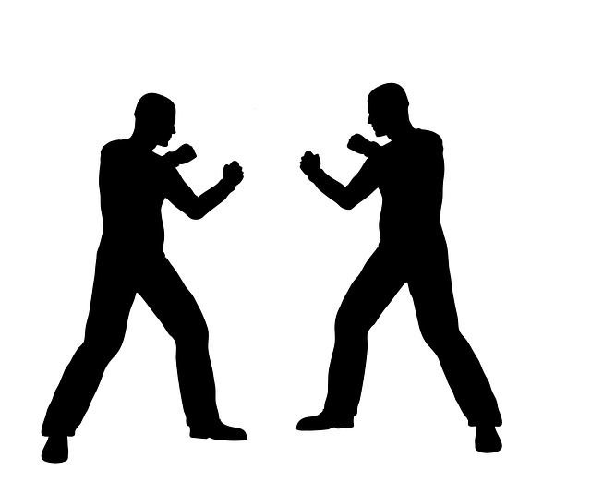
Conflict solving vs Conflict management
click
click
Conflict Solving
Conflict resolution refers to the process of addressing and settling disputes, disagreements, or conflicts between individuals, groups, or organisations in a constructive and peaceful manner. It involves finding solutions that satisfy the interests and needs of all parties involved, while minimising negative emotions and potential damage to relationships.
Unlike conflict solving, which aims to find a complete and final solution to a conflict, conflict management focuses on the ongoing management of conflicts, recognising that some conflicts may not be fully resolved but can still be managed in a productive manner.
Effective conflict solving aims to prevent escalation of the conflict and instead seeks to find common ground and mutually agreeable solutions
Conflict Management
Conflict management refers to the process of handling and controlling conflicts in a way that minimises their negative impact while promoting understanding, collaboration, and effective problem-solving.
Source | Pixabay license

Slide 14
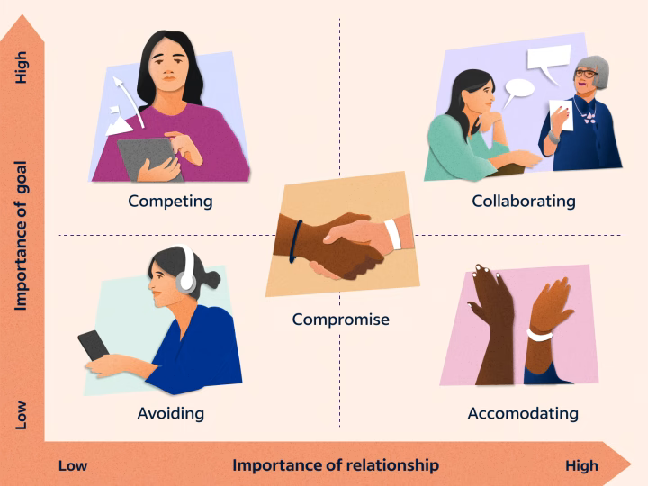

Methods for Solving Conflicts
High
From the perspective of the actors in conflicts, individuals have two primary motivations in conflict: the desire to obtain their own goals versus the desire to retain interpersonal relationships.
Based on this 5 methods for conflict-solving are devised:
Competing
Collaborating
Importance of goal
Compromise
Low
Avoiding
Accommodating
Low
Importance of relationship
High
Source |https://www.indeed.com/career-advice/career-development/conflict-resolution-strategies

Slide 15
Methods for Solving Conflicts
Competition (Win-Lose)
Used when
Decisional fastness is of vital importance
Problems can be solved only by unpopular means that are likely to be opposed by the majority of group members
Vital group issues are at stake and the group leaders are convinced that their view is correct
Against those taking a lenient attitude
Collaboration (Win-Win)
Used when it is necessary
To find integrative solutions for interests of majour importance
To combine opposing opinions
To stimulate mutual learning
To win everybody’s adherence by considering multiple interests and by achieving general consensus
Source | Adapted from Talmaciu, I., & Mărăcine, M.S. (2010)

Slide 16
Methods for Solving Conflicts
Compromise
Used when
Goals are important but the risk of triggering a conflict is too high
Opponents have equal power and are determined to implement ideas that mutually exclusive
A balance needs to be achieved
An opportunity for honourable withdrawal needs to be provided when both competition and collaboration cannot entail a positive outcome
Avoidance
Used when
The problem is unimportant or negligible when compared to other more pressing issues
There is no change of satisfying your needs
The timing or circumstances are not conducive to resolution
Triggering a conflict is more plausible than solving the problem
It is necessary to provide a cooling-off period and allow for further reflection before addressing the conflict
Source | Adapted from Talmaciu, I., & Mărăcine, M.S. (2010)

Slide 17
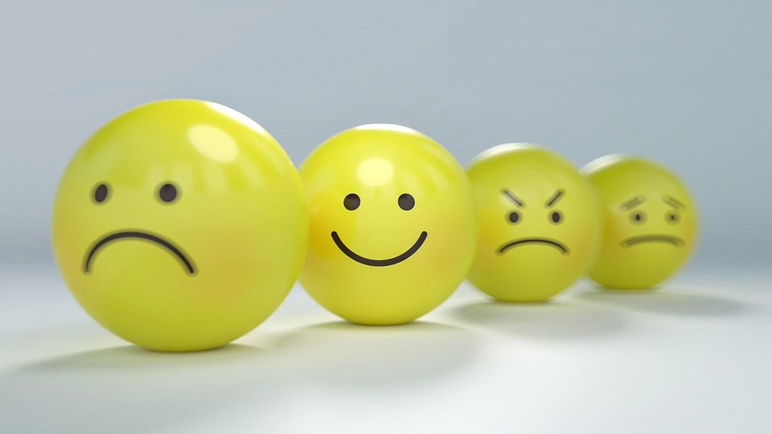
Methods for Solving Conflicts
Adjustment (Accommodation)
Used
When one reaches the conclusion that one’s judgments are not correct
To allow another better option to be applied
To obtain a social loan in anticipation of future more important problems
To minimise losses
When the situation is out of control
When harmony and stability are essential.
Source | Adapted from Talmaciu, I., & Mărăcine, M.S. (2010); Pixabay license

Slide 18
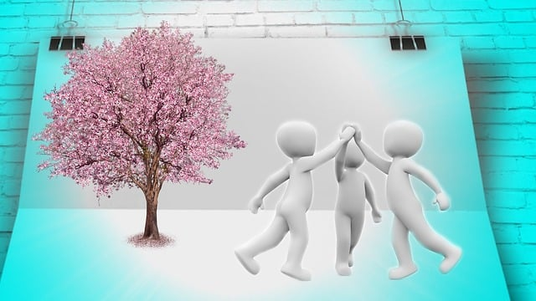
Conflict Solving Techniques
Define the subject of disagreement
Narrow the area of dispute
Widen the area of possible solutions
Build and promote conflict-solving skills in individuals such as self-awareness, self-control, problem-solving, collaboration, empathy, active listening, clear expression and assertive communication
Enhance communication where the parties maintain self-respect, expresses personal needs, and manage to defend their own rights without abusing or dominating others
Refer to third-party mediation - mediators help parties see each other's perspectives and work toward a mutually agreeable solution
Source | Adapted from Talmaciu, I., & Mărăcine, M.S. (2010);
https://pixabay.com/pt/illustrations/gest%C3%A3o-trabalho-em-conjunto-encontro-2161487/

Slide 19
Living Together Skills
Eventually, harmonious living together and conflict solving require a combination of interpersonal skills and emotional intelligence such as:
Empathy – understanding and sharing the feelings of others, putting yourself in their shoes to comprehend their perspective.
Respect and Tolerance – appreciating and respect individual differences, including cultural, religious, and personal beliefs.
Active Listening – paying full attention when others are speaking, and show that you are engaged in the conversation
Expressing Yourself - clearly articulating your thoughts, feelings, and needs without aggression or blame.
Negotiation – finding compromises that work for all parties involved in a disagreement.
Managing Anger – controlling one’s emotions during conflicts, and avoid saying or doing things impulsively.
Teamwork and Collaboration – including equitably sharing of benefits and responsibilities to avoid feelings of imbalance or resentment.
Patience and Understanding
Self-awareness – recognising one’s own emotions and self-reflections
Positive Attitude – maintaining a positive outlook, focusing on the good aspects of the relationship and the people involved.

Slide 20
Skills for Living and Working Together
Some of these skills have been codified as transversal (personal) skills in the multilingual classification of European Skills, Competences, and Occupations, ESCO v.1.1.1:
T2: Thinking skills and competences
Skills and competences relating to the ability to apply the mental processes of gathering, conceptualising, analysing, synthesising, and/or evaluating information gathered from, or generated by, observation, experience, reflection, reasoning, or communication. They include the ability to evaluate and use information of different kinds to plan activities, achieve goals, solve problems, deal with issues and perform complex tasks in routine and novel ways.
T3: Self-management skills and competences
Skills and competences requiring individuals to understand and control their own capabilities andlimitations and use this self-awareness to manage activities in a variety of contexts. They include the ability to act reflectively and responsibly, to accept feedback, adapting to change and to seek opportunities for personal and professional development.
T4: Social and communication skills and competences
Skills and competences relating to the ability to interact positively and productively with others. This is demonstrated by communicating ideas effectively and empathetically, coordinating one’s own objectives and actions with those of others and acting in ways which are structured according to values, ensuring the well-being and progress of others, and offering leadership.

Slide 21
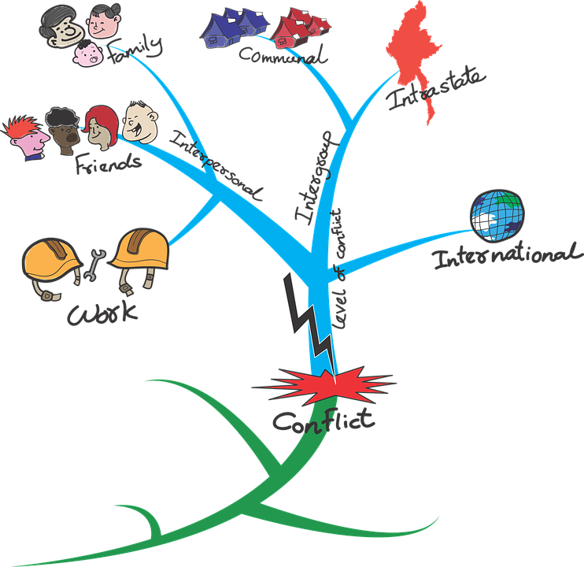
The most important...
Keep in mind that:
  Conflicts are an inherent part of group dynamics - whenever individuals with diverse backgrounds, perspectives, and interests come together to collaborate, conflicts can emerge due to the differing viewpoints and goals.
  Intercultural and/or value-based conflicts can rarely be productive.
  It is necessary to look for win-win solutions rather than solutions in which one wins and the other one loses.
  When a conflict arises or a problem needs to be solved, it is essential that everyone focuses on solving the problem and not on blaming others for it.
  Assess each choice objectively and opt for the greater good!
Source | Pixabay license

Slide 22
References and further reading
Council of Europe (2012). T-KIT: Youth Transforming Conflict. Retrieved from https://pjp-eu.coe.int/en/web/youth-partnership/t-kit-12-youth-transforming-conflict
Fisher, R. (2006). Sources of Conflict and Methods of Conflict Resolution. Retrieved from http://www.communicationcache.com/uploads/1/0/8/8/10887248/sources_of_conflict_and_methods_of_resolution.pdf .
Gordon, Jason (2022). Conflict Management in Groups - Explained. Retrieved from https://thebusinessprofessor.com/en_US/management-leadership-organizational-behavior/conflict-management-in-groups
Hener, G. (2013). Managing Conflicts within Organizational Culture in Local Public Structures. Retrieved from https://www.semanticscholar.org/paper/MANAGING-CONFLICTS-WITHIN-ORGANIZATIONAL-CULTURE-IN-Hener/9e186d8523a2c83197614590d78c937436ab3cab
Holt, J., & DeVore, C.J. (2005). Culture, Gender, Organizational Role, and Styles of Conflict Resolution: A Meta-analysis. International Journal of Intercultural Relations, 29, 165-196. Retrieved from https://www.sciencedirect.com/science/article/pii/S0147176705000702?via%3Dihub
Udupa S., Gagliardone I., Deem A., & Csuka, L. (2020). Hate Speech, Information Disorder, and Conflict. Social Science Research Council (SSRC). Retrieved from https://s3.amazonaws.com/ssrc-cdn1/crmuploads/new_publication_3/the-field-of-disinformation-democratic-processes-and-conflict-prevention-a-scan-of-the-literature.pdf
Talmaciu, I., & Mărăcine, M.S. (2010). Sources of Conflicts within Organizations and Methods of Conflict Resolution. Management and Marketing, 123-132. Retrieved from https://www.semanticscholar.org/paper/SOURCES-OF-CONFLICTS-WITHIN-ORGANIZATIONS-AND-OF-Talmaciu-M%C4%83r%C4%83cine/0c2c95100714cceba34fbbc45c70c6492ec7564b
Wilson, Ch. (2022). 14 Conflict Resolution Strategies for the Workplace. Retrieved from https://positivepsychology.com/conflict-resolution-in-the-workplace/?utm_content=cmp-true

Slide 23
Congratulations!
You have completed this part
Funded by the European Union. Views and opinions expressed are however those of the author(s) only and do not necessarily reflect those of the European Union or the European Education and Culture Executive Agency (EACEA). Neither the European Union nor EACEA can be held responsible for them.

