Slide 1



https://www.costaid.eu
Module 4 Enabling Dialogue
Funded by the European Union. Views and opinions expressed are however those of the author(s) only and do not necessarily reflect those of the European Union or the European Education and Culture Executive Agency (EACEA). Neither the European Union nor EACEA can be held responsible for them.

Slide 2








Partners

Slide 3
Modules
4. Enabling dialogue
5. Ethics
6. Reflective skills
7. Digital skills
1. Awareness
2. Critical thinking
3. Conflict solving

Slide 4

Objectives
To create understanding why dialogue is important, both in general and in the context of dealing with misinformation
To explain the important fundamentals of dialogue
To build skills in creating an effective dialogue
To clear up difficulties in intercultural communication

Slide 5

Counteracting belief in information disorder
Echo chamber
an environment in which a person encounters only beliefs or opinions that coincide with their own, so that their existing views are reinforced, and alternative ideas are not considered.
Counteracting belief in information disorder could prove challenging is some cases, because beliefs are by definition stable ideas that do not get changed easily. This can differ per person and per belief, depending on the strength of the belief.
For example, some people are just misinformed and are openminded towards other perspectives. Some others, however, can have more radical, closeminded beliefs. This can happen when a person is part of an echo chamber for example.
In both cases, but especially the latter, it is crucial to engage in dialogue.
Source echo chamber definition | Source belief definition | Source image

Slide 6

The importance of dialogue
In order to “change someone’s mind” about certain beliefs or ideas, they have to come into contact with other perspectives, facts, insights and attitudes. Talking with them is a very good way to offer these perspectives.
In the case of belief in information disorder, one can adress feelings, ideas and facts on a personal level through conversations, in order to hopefully counteract their attitudes based on falsehoods.
However, not all dialogue has the same effect…
image: Flaticon.com | Source

Slide 7
A safe environment
Dialogue can differ extensively: some conversations are combative in nature, while others are respectful. As you could expect, combative conversations do not amount to anything usually. Due to the agressive nature of the dialogue it will end up in emotional, close-minded arguments.
In order for someone’s mind to change on a subject, it is crucial to stay respectful and foster an open dialogue. In order to have an effective respectful dialogue, the environment in which it takes place should be safe. This creates opportunities to challenge their own beliefs and engage with different perspectives without judgement.
In order to create such a safe environment, there are four core elements:
Give respect
Get respect
Source image

Slide 8

Fundamentals for effective dialogue
Relationships should be based on trust so that adolescents and young adults feel comfortable expressing their doubts
The dialogue should be egalitarian
Provide guidance in the dialogue
Reject agression
Image by rawpixel.com on Freepik
Source image

Slide 9
A relationship of trust (1/4)
Trust
trust in communication refers to the generalised expectancy that a message received is true and reliable and that the communicator demonstrates competence and honesty by conveying accurate objective, and complete information.
In order to have effective dialogue about hard subjects (e.g. information disorder), a relationship of trust should be achieved.
Without trust there is no possibillity for a con-versation to be effective, because the person does not expect you or your words to be reliable or honest. Therefore, they will not engage in the dialogue.
When there is a relationship of trust, the person is more motivated to cooperate in the conversation and be more comfortable to expressing themselves.
Source 1 | Source 2

Slide 10
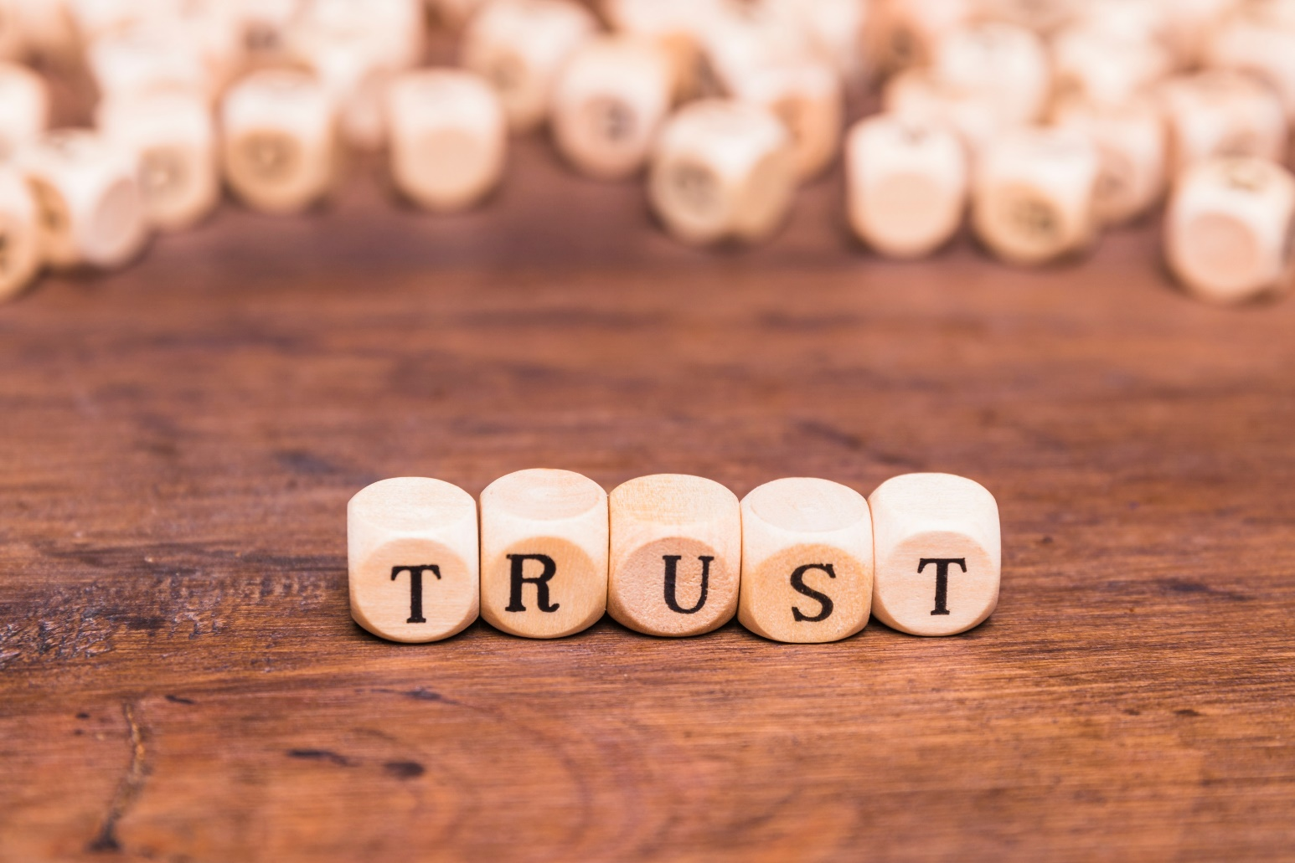
How to achieve trust (2/4)
Trust is not easily achieved, but mostly built up over time. Trust is built up by open and prompt communication amongst each other. In this communication, you will collect evidence of trustworthiness and credibility. Showing goodwill and intimacy often creates such a bond.
Whenever such a bond is not yet in place because the youth worker/teacher has not had much time with the adolescent, but an effective dialogue should be had anyway, there is an important skill that could be useful: Affective professionalism.
Affective professionalism means that as a professional, you do not primarily work based on authority and cognitive action but rather on establishing a connection and showing empathy/engagement in what concerns the young person. Love for young people, empathising with them, genuinely getting to know them, taking an interest in them, and paying attention to their positive aspects are crucial.
Image by Freepik | Source information

Slide 11
An effective tool of affective professionalism (3/4)
One important and useful tool that can help with the affective professionalism skill is self-disclosure. Depending on the situation, it helps to share a bit about your own beliefs, values, ideals, disappointments, frustrations and anger.
The gradual revelation of feelings and personal experiences promotes both a sense of trust and the knowledge you have of someone else.
This happens verbally, non-verbally and contextually. So, for example, by literally saying something, by facial expressions, body posture and even by the brand and color of clothes you wear.
Self-disclosure
Self-disclosure is mostly found to be beneficial, but should be reconsidered per context. Every person is complex and different and can react differently to similar situations. However, there are some general guidelines for applying self-disclosure:
Source image

Slide 12
Guidelines for self-disclosure (4/4)
Do self-disclosure infrequently. The power of self-disclosure comes precisely because it is not habitual.
Do it thoughtfully and deliberately. Try to find out what the client is actually asking before answering a question that requires self-disclosure. One can then better discuss the client's underlying need.
Choose words carefully: how empathetic or emotionally charged the telling is. The degree of intimacy should match the patient's need. Overly personal self-disclosure is relatively unfavorable, but some degree of intimacy is needed.
Be responsive before, during and after self-disclosure. So be sure to get feedback back, through questions or observation, on how the client is taking it up so you can further tune in.

Slide 13

2. An egalitarian dialogue (1/2)
An egalitarian dialogue is one where all participants are equal. Potential power imbalances between the participants (e.g. teacher and student) should not play a role. Instead, the communication should stimulate others to express their beliefs, attitudes and opinions in order to reach a mutual understanding.
Source definition | Source information | Source image

Slide 14
A level playing field creates openness (2/2)
An egalitarian dialogue is focused on sharing ideas on an equal level.
This equality puts the focus on the validity of the arguments and what is said in the conversation, instead of forcing a particular way of thinking on someone.
In this way, the form of egalitarian dialogue creates a level playing field, creating a environment of safety and openness.
When a first liner want to have a conversation with an adolescent who shows signs of belief in information disorder, it is crucial that the first liner does not condemn this belief.
Hear them out, try to understand where they are coming from, and put up your own arguments without belittling theirs.
This way, they will be more open towards your argumentation.

Slide 15

3. Providing guidance
Stay focused. While it is important to let the adolescent say what they need to say the point of the conversation should not be lost: you are there to understand and possibly counteract belief in information disorder.
Provide sensible and respectful suggestions of issues to consider, including moral and ethical points. Keep in mind to not be condemning or judgemental that the dialogue should remain egalitarian, however this does not mean that one can not respectfully disagree and show alternative perspectives.
Encourage and positively reinforce constructive engagement in the conversation.
The role of the first liner is not only to provide a safe space for dialogue, but also to participate in the dialogue in order to try to counteract the belief in information disorder. In order to do this, there are some crucial point to keep in mind:
Source information | Source image

Slide 16

4. Reject agression (1/4)
As said before, agression in dialogue leads to close-mindedness and emotion, and without an open mind the conversation is doomed to fail from the start.
It can happen that the dialogue can invoke agressiveness in the adolescent, even though the dialogue is held respectfully. In this case, try to deescalate the situation how you see fit. If it persists, the dialogue should be continued another time.
Source information | Source image

Slide 17

How to reject aggression (2/4)
In order to prevent aggression and keep a safe and openminded conversation, you should model civil and respectful behaviour through your own actions.
When the facilitator speaks with respect and care, the adolescent is more likely to emulate this behaviour.
In order to maintain this behaviour, active listening is a key skill to use:
Source information | Image by pch.vector on Freepik

Slide 18
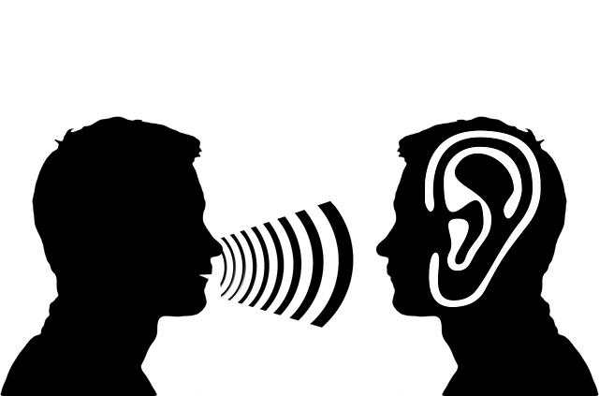
Active listening (3/4)
Active listening: demonstrating to the other person that you are truely hearing them. This contributes to avoiding conflict in the dialogue.
Active listening can be done in many ways. It can be remembered by the mnemonic device "LISTEN":
Look interested, get interested.
Involve yourself by responding.
Stay on target.
Test your understanding.
Evaluate what you hear.
Neutralise your feelings.
Source information | Image source

Slide 19

Examples of active listening (4/4)
Think about your body language and posture and how they look like to them;
Do not interrupt;
Use silence effectively, in order to wait for them to say what they need to say;
Summarise or paraphrase the emotion and content of what you interpret they are saying. You are not agreeing with the person, but just reiterating what they told;
Affirm them when you agree with what they are saying.
Image by asier_relampagoestudio on Freepik | Source information

Slide 20

Other skills of dialogue (1/3)
Critical thinking helps to identify assumptions and biases, and to analyse information, to reflect upon its sources and to be able to make informed and rational judgements. Ask the adolescent to explain why they have reached their conclusions and support their points of view, in order to understand their journey. More on this can be found in Module 2: Critical thinking.
Source information | Source image

Slide 21

Other skills of dialogue (2/3)
Questioning is invaluable in dialogue: it helps to enrich our understanding. Good questions, however, do not only give us more information, but enable you to create a deeper understanding of one's experiences and understand how and why they see the world as they do. Good questions are response questions (questions that are reactions on information from the dialogue); they help to deepen the understanding.
Source information | Source image

Slide 22

Other skills of dialogue (3/3)
Reflection mostly happens after the dialogue has taken place, because it takes space and time in order to reflect on what has taken place. However, it is critical to reflect, in order to understand better what you have learned and how this could be improved in the future.
Source information | Image by Freepik

Slide 23
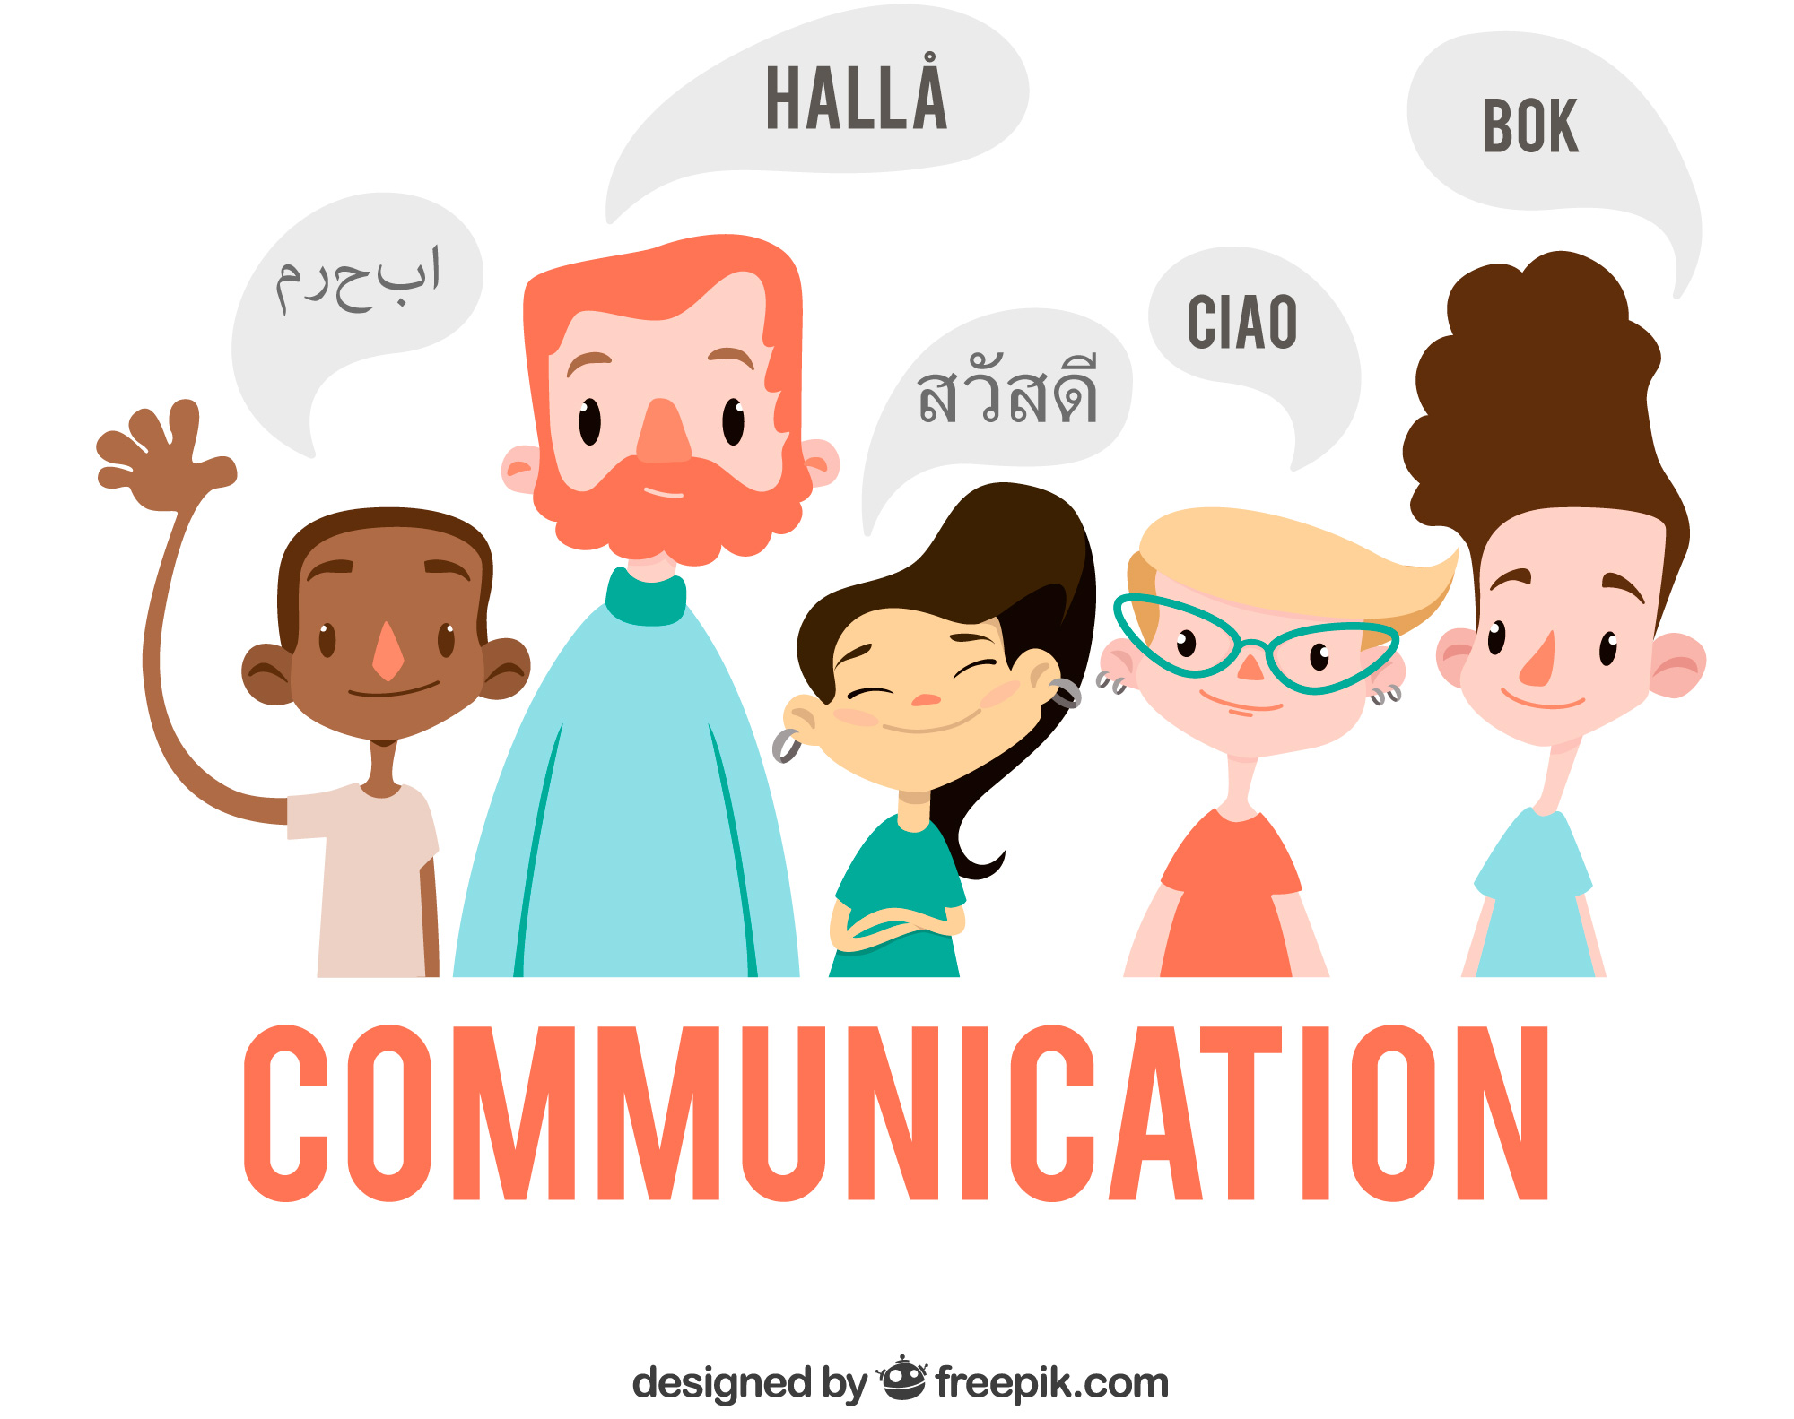
Intercultural communication
Image by Freepik
Source image

Slide 24

Intercultural communication (1/4)
It is important to recognise that, while communication is imperative to mankind, ways of communication are not entirely interchangeable across different cultures.
Culture is an incredibly broad phenomenon, which can be found in everything in their environment: in institutions, in objects we use on a daily basis, in the way people behave, in ideas and in values.
Because of this, culture influences people's perceptions, thought patterns, judgements and actions.
In social interactions, the influence of culture can be seen in greeting rituals, clothing, mimicry, body language and use of language. A clear example of this is that some cultures are more direct in communicating, while others are more indirect and use tone and silences to insinuate the message.
Image by pikisuperstar on Freepik| Source information

Slide 25
Examples of misinterpretations in intercultural communication (2/4)
The meaning of silence varies across cultures. In some, it may signify respect, for instance in China. Conversely, in Australia, silence is sometimes perceived as either shyness or a sign of disinterest.
An English businessman has written a letter to a Japanese businessman, which has to be translated. He used the sentence "I wonder if you would prepare an agenda for our meeting". The use of "wonder" in this sentence is to politely ask to do something. However, in Japanese "wonder" can be translated as "doubt". This would create the sentence "we doubt that you would prepare an agenda for our meeting". The well-intentioned sentence is transformed into one which could be considered rude.
Source information

Slide 26
Examples of misinterpretations in intercultural communication (3/4)
The appropriate distance for conversing with a stranger differs from one culture to another, and when someone disregards these unspoken norms, it often makes us feel uneasy.
Gestures and eye contact can convey powerful, yet differing messages across cultures. For example: Arabs, Latin Americans, and Southern Europeans maintain direct eye contact with their conversational partners, while Asians and Northern Europeans tend to employ a peripheral gaze or avoid eye contact altogether. If the eye contact is too prolonged, this may even be interpreted as sexual interest.
Source information

Slide 27
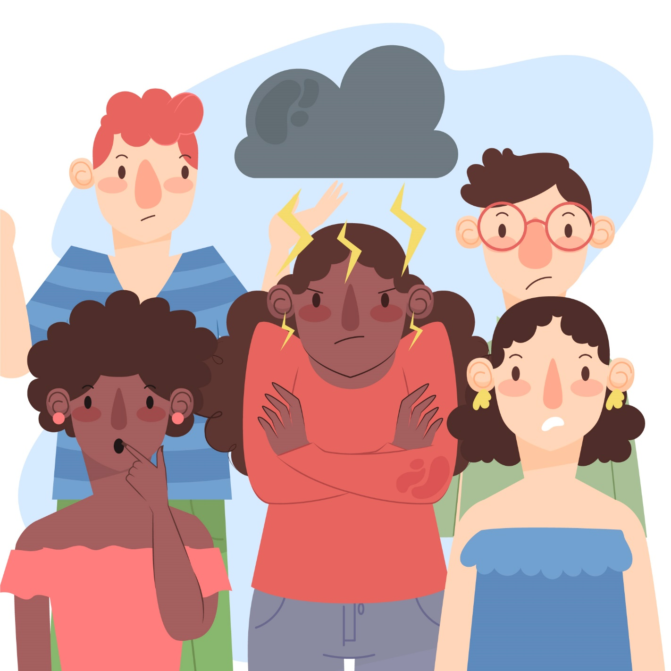
How to avoid intercultural misinterpretations (4/4)
There is no clear-cut way to dismiss intercultural misinterpretations alltogether. The way people act and think is molded by their culture and it is hard to change this.
However, in order to try and avoid them as much as possible, there are two important steps to take:
Increase your knowledge of other cultures and their habits in communication in order to understand them better.
Talk about it. When you adress the fact that there could be problems with interpretation, you create the opportunity for them, as well as for yourself, to talk about it. For example: Ask if you understood them correctly, or repeat the message as you understood it.
Image by Freepik

Slide 28
References and further reading (1/2)
The guidelines of the COSTAID-project on costaid.eu, on which these slides are based.
Engdahl, E., & Lidskog, R. (2012). Risk, communication and trust: Towards an emotional understanding of trust. Public Understanding of Science, 23(6), 703–717. https://doi.org/10.1177/0963662512460953
Gibson, C. B., & Cohen, S. G. (2003). Virtual teams that work : creating conditions for virtual team effectiveness. In Jossey-Bass eBooks. https://ci.nii.ac.jp/ncid/BA62890363
Jamison, I. (2017). Essentials of Dialogue: Guidance and activities for teaching and practising dialogue with young people. In Tony Blair Institute for Global Change. Tony Blair Institute of Global Change. https://www.institute.global/insights/public-services/essentials-dialogue
Jones, A., & Draper, S. (n.d.). Helpsheet Giblin Eunson Library: intercultural Communication 2 [Online forum post]. The University of Melbourne: Faculty of Business & Economics. https://library.unimelb.edu.au/__data/assets/pdf_file/0003/1924095/Intercultural_Communication2.pdf

Slide 29
References and further reading (2/2)
Renn, O., & Levine, D. (1991). Credibility and trust in risk communication. In Springer eBooks (pp. 175–217). https://doi.org/10.1007/978-94-009-1952-5_10
Roca, E., Meridio, G., Gómez, A., & Rodríguez-Oramas, A. (2022). Egalitarian dialogue enriches both social impact and research methodologies. International Journal of Qualitative Methods, 21, 160940692210744. https://doi.org/10.1177/16094069221074442
Thomas, A., Kinast, E., & Schroll-Machl, S. (2010). Handbook of Intercultural Communication and Cooperation. https://doi.org/10.13109/9783666403279
Unesco. (2016). A Teacher’s Guide on the Prevention of Violent Extremism. United Nations Educational, Scientific and Cultural Organization. https://doi.org/10.54675/xrjk7971
Walton, D. (2010). A dialogue model of belief. Argument & Computation, 1(1), 23–46. https://doi.org/10.1080/19462160903494576

Slide 30
Congratulations!
You have completed this part
Funded by the European Union. Views and opinions expressed are however those of the author(s) only and do not necessarily reflect those of the European Union or the European Education and Culture Executive Agency (EACEA). Neither the European Union nor EACEA can be held responsible for them.

