Slide 1



https://www.costaid.eu
Module 1 Awareness
Funded by the European Union. Views and opinions expressed are however those of the author(s) only and do not necessarily reflect those of the European Union or the European Education and Culture Executive Agency (EACEA). Neither the European Union nor EACEA can be held responsible for them.

Slide 2








Partners

Slide 3
Modules
4. Enabling dialogue
5. Ethics
6. Reflective skills
7. Digital skills
1. Awareness
2. Critical thinking
3. Conflict solving

Slide 4

Objectives
To explain what information disorder entails
To create awareness on the causes and other influences regarding belief in information disorder
To explain how these influences function and affect one’s perception
To build skills on how to identify and handle belief in information disorder

Slide 5
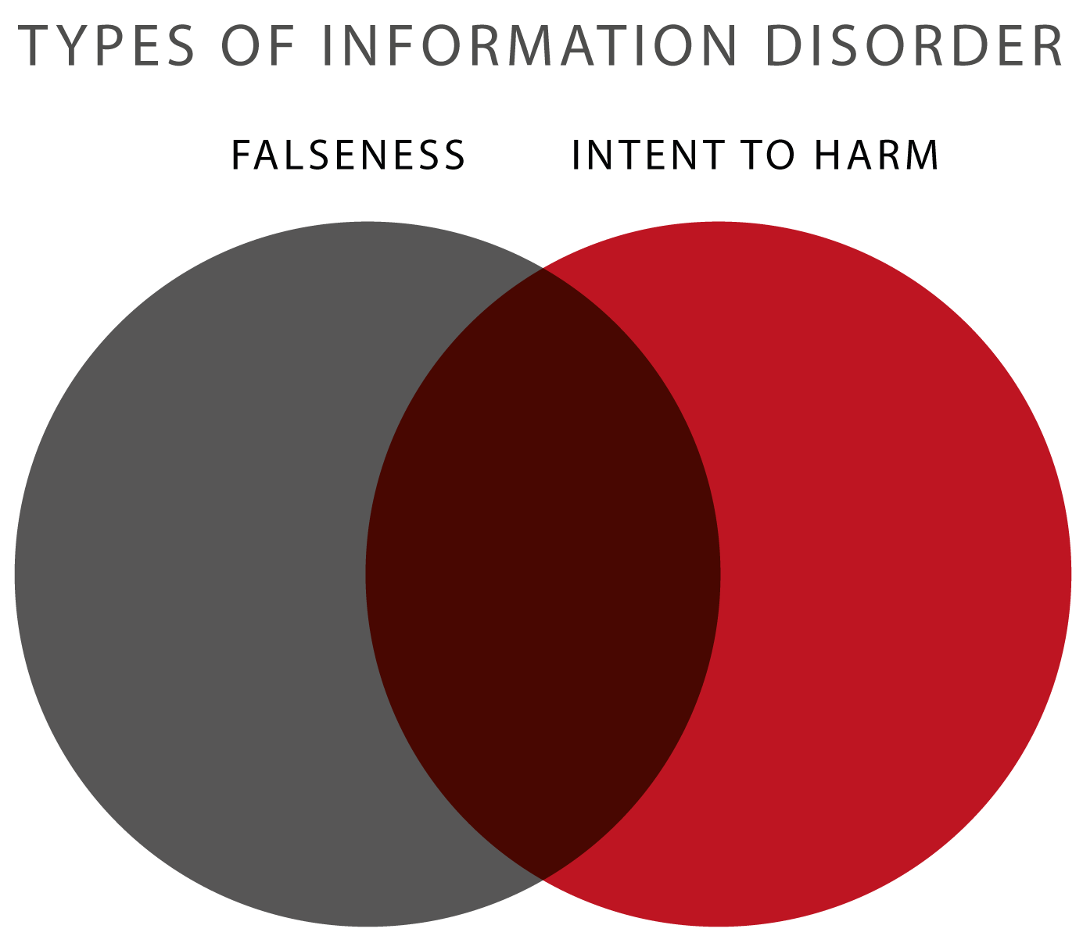
What is Information Disorder?
Information disorder is the overarching term for three types of misleading and/or harmful information.
These types are divided in two categories:
  Whether the information is false or not.
  Whether the information is spread with malicious intent in order to harm others.
The three types:
    Misinformation: false, no intent to harm
    Disinformation: false, intent to harm
    Malinformation: true, intent to harm
Disinformation
Untrue information, spread with malicious intent to mislead the receiver of the information.
Often used to promote specific moral or political perspectives.
Malinformation
Based on factual information, but is spread with intent to cause harm. Often it is information taken out of context or exaggerated in order to promote an agenda, e.g. hate speech.
Misinformation
Untrue information, spread without the knowledge that it is false, e.g. due to a mistake or a misinterpretation.
Source image (altered)

Slide 6
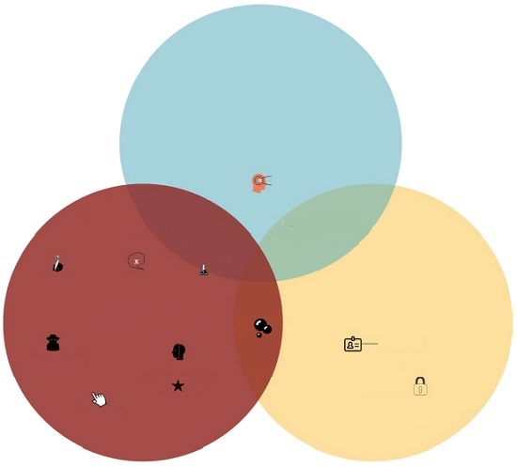
Examples of Information Disorder
All 3 forms of information disorder are prevalent in society.
Misinformation is mostly based on ignorance and personal biases. These can cause misinterpretations which, when shared, create misinformation.
Disinformation can be a very large issue, for example the sharing of “fake news” by a media outlet. However, disinformation can also be found in smaller instances, for example companies which leave fake reviews on their own products/services or articles that use extravagant SHOCKING titles in order to mislead people into clicking on them.
Malinformation for example can be the gathering of personal information through phishing, but also using this personal information for e.g. doxxing, indentity theft or besmirching someone’s reputation.
Misinformation
Bias
Misleading maps, charts & graphics
Conspiracy theories
Propaganda
Retracted papers
Satire
Hoax
Disinformation
Malinformation
Filter bub-
bles
Phishing
Fake news
Imposters websites
Misuse of personal info
Fake reviews
Misuse of confidential info
Clickbait
Source image (altered)

Slide 7
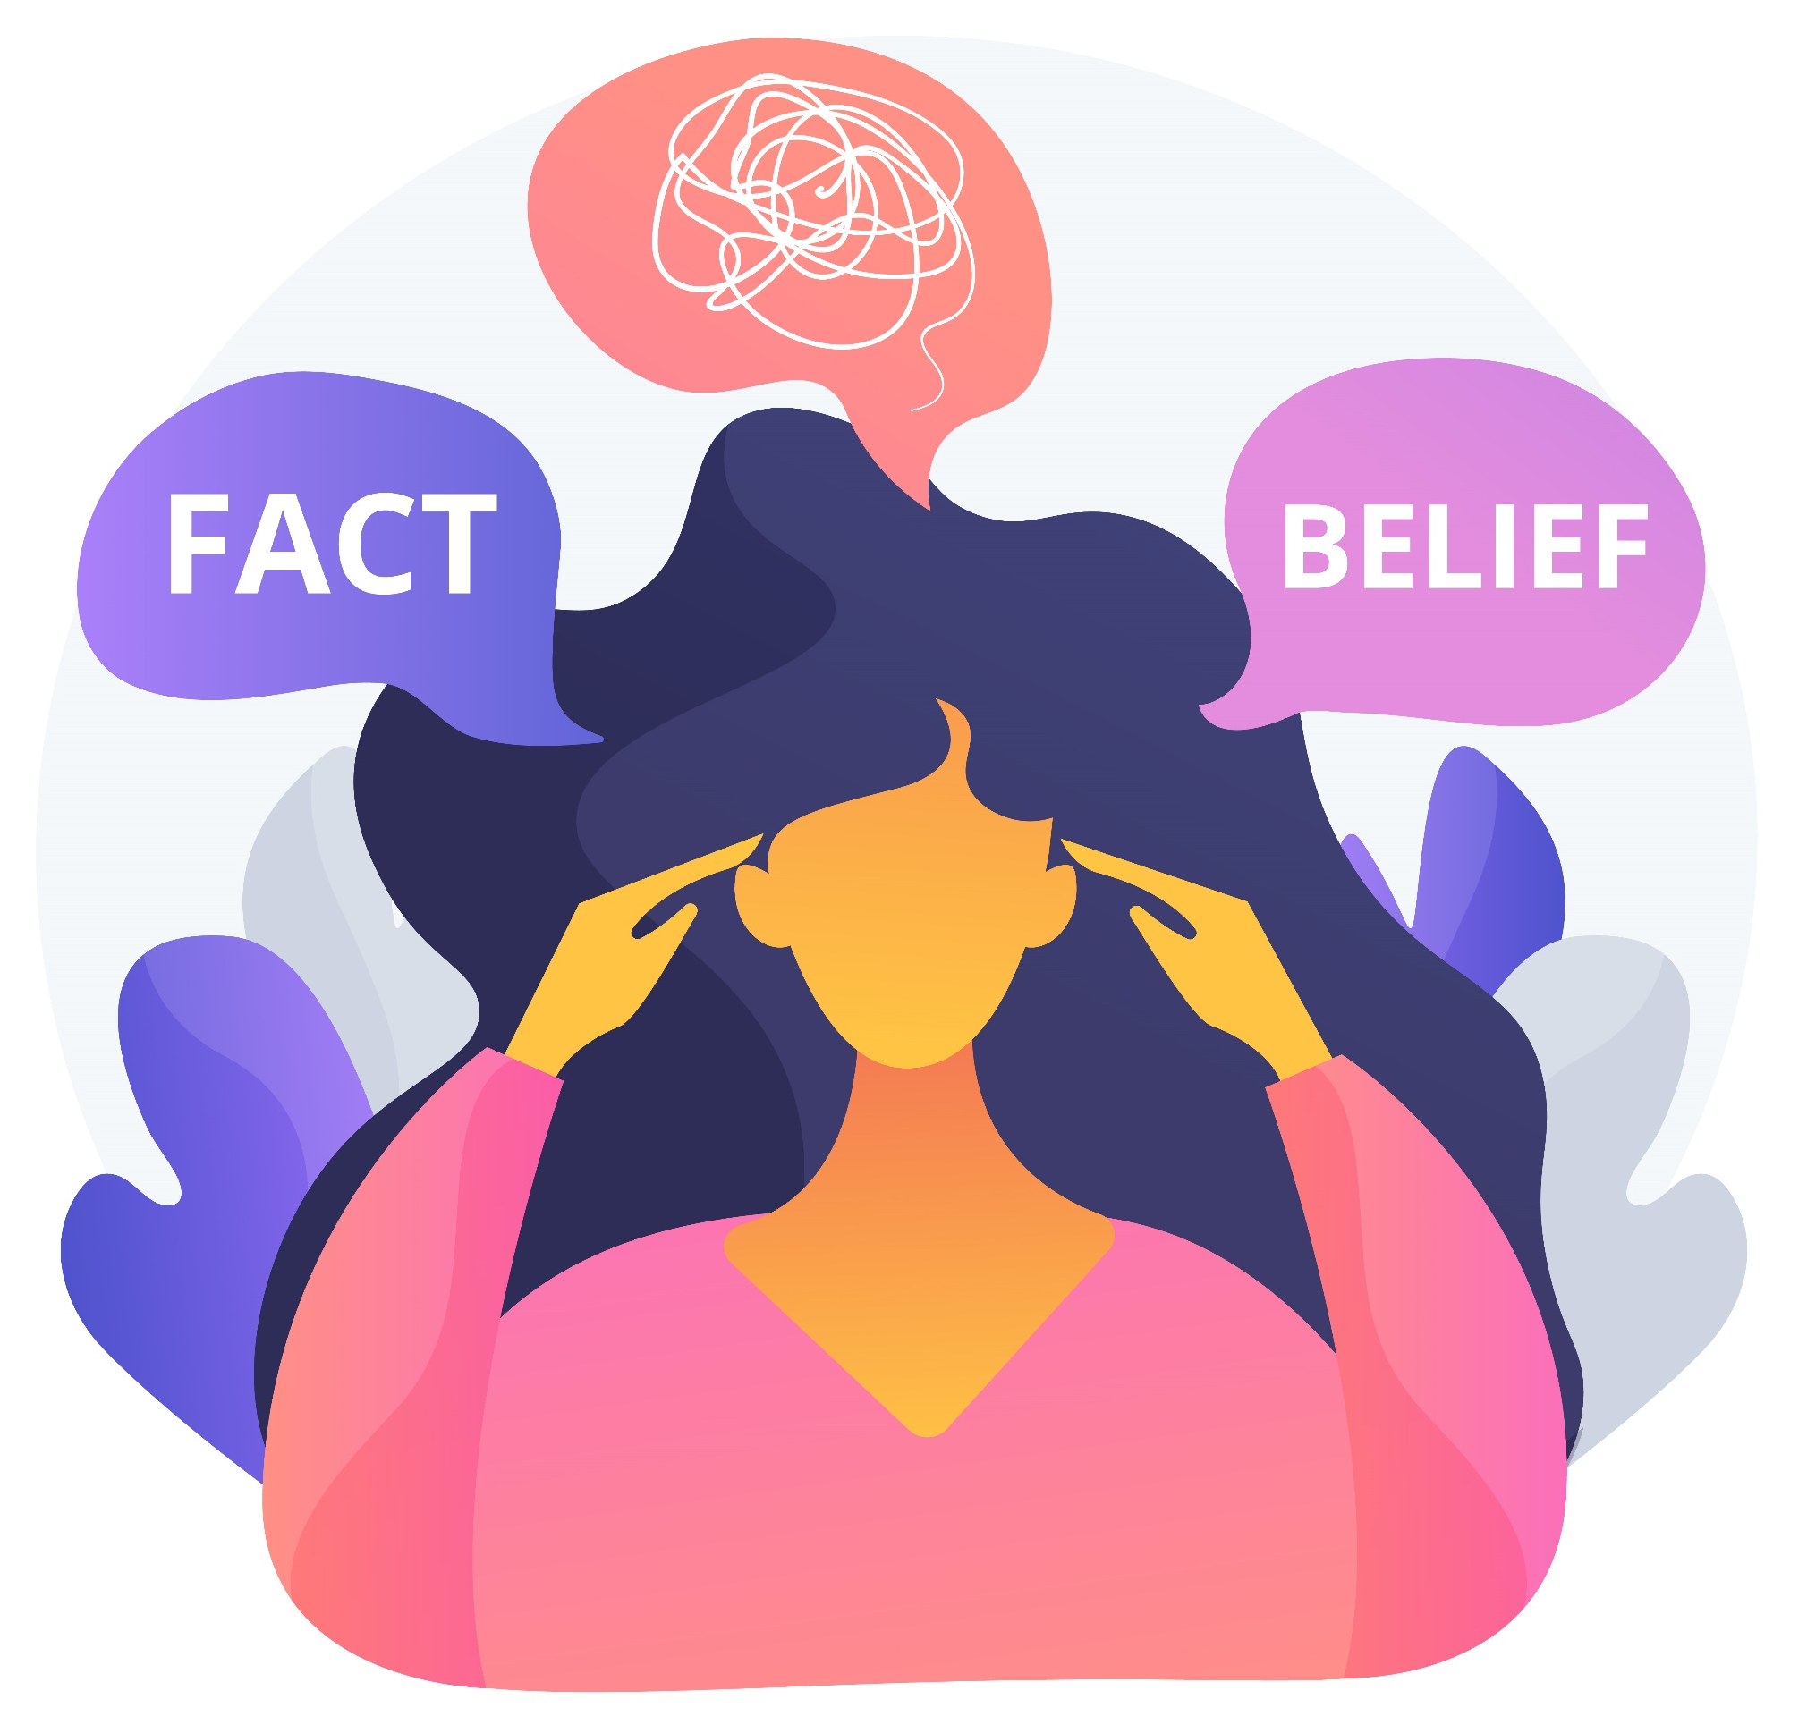
Belief in Information Disorder:
a Problematic Behaviour
Image by vectorjuice on Freepik.

Slide 8
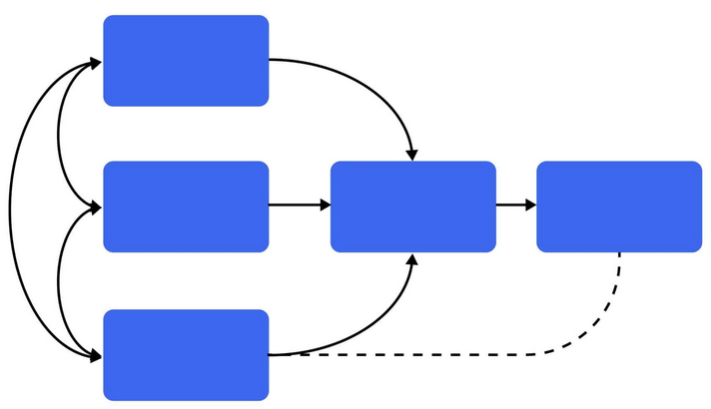
The Theory of Planned Behaviour
The theory of planned behaviour is a theory that explains how people come to perform the behaviours they perform.
In the model you can see that in order to perform behaviour, one should have intention.
Intention is created by a combination of 3 factors:
Attitudes / personal beliefs
Subjective norms
Perceived behavioural control
Attitudes
Subjective norms
Behaviour
Intention
Perceived Behavioural control
Source information & image (altered)

Slide 9
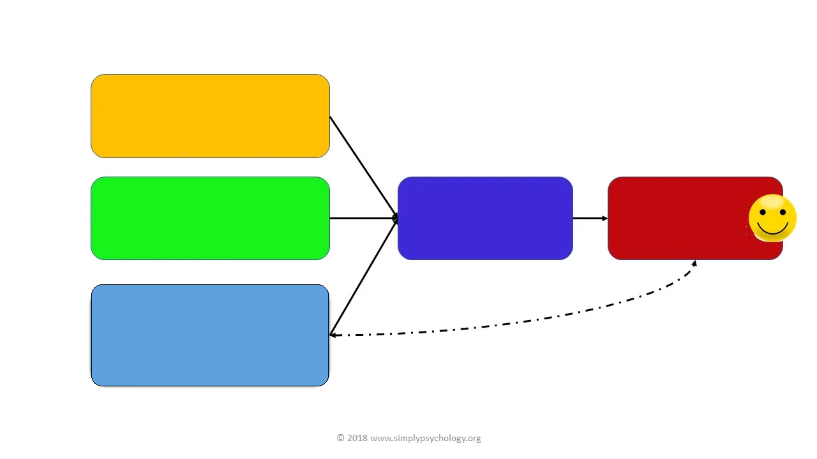
An Example of This Theory
This is an example of this theory in use.
Their personal attitudes, the influence of their social environment and the level of control they perceive to have lead them to a certain behaviour: to stop smoking.
Attitudes:
Smoking is relaxing;
Smoking costs a lot;
Smoking is bad for my health.
Subjective norms:
My colleagues smoke;
My girlfriend does not approve of smoking.
Intention:
I will stop smoking
Behaviour:
I stop smoking
Perceived behavioural control:
I know I could stop with a bit of help;
I can rely on my girlfriend to help me do it.
Now let’s use this model for belief in information disorder!
Source image (altered)

Slide 10

Attitude / Personal beliefs (1/2)
Belief
is a state or habit of mind in which trust or confidence is placed in some perons or thing.
click
A belief is an idea that a person holds as being true. Belief can originate from various sources, such as:
  a person’s own observations or experiments;
  the adoption of cultural and societal standards (e.g. religion);
  what others tell them (e.g. education or mentoring).
A possible belief stays with the person until they embrace it as true and incorporate it into their individual belief system.
Each person assesses and seeks solid reasons or evidence for these possible beliefs in their own way.
Once a person acknowledges a belief as a truth, they are ready to defend, it can be said to constitute part of their belief system.

Slide 11
Attitude / Personal beliefs (2/2)
Example
A person let their child be vaccinated and the child was later diagnosed with autism spectrum disorder.
This person could be more succeptible to believe news stories or social media posts saying that vaccines cause autism, than people who have not had this personal experience.
In conclusion: a person’s attitude towards something is created by the experiences and (life) lessons they have encountered throughout their lifetime.
In the case of belief in (false) information, people are more prone to believe info when it alligns with the personal attitudes they have garnered in their life (confirmation bias). However, these personal experiences do not always reflect the world accurately.
Example
A person has contracted COVID-19 and they did not get very sick. Neither did anyone in their social circle.
This person could be more succeptible to believe news stories or social media posts saying that the COVID-19 pandemic is overblown.

Slide 12

Subjective norms / Social influence (1/3)
Someone’s social environment plays a significant role in their behaviour, as seen in the theory earlier presented.
In short, the social environment of a person consists of their social relationships, their physical surroundings and the cultural milieu in which they function and interact.
For example, the country in which someone grows up in is part of their social environment, just as social groups like their family, their friends, their school, their peer group, and even the online spaces they frequent.
Source definition | Image by Freepik

Slide 13
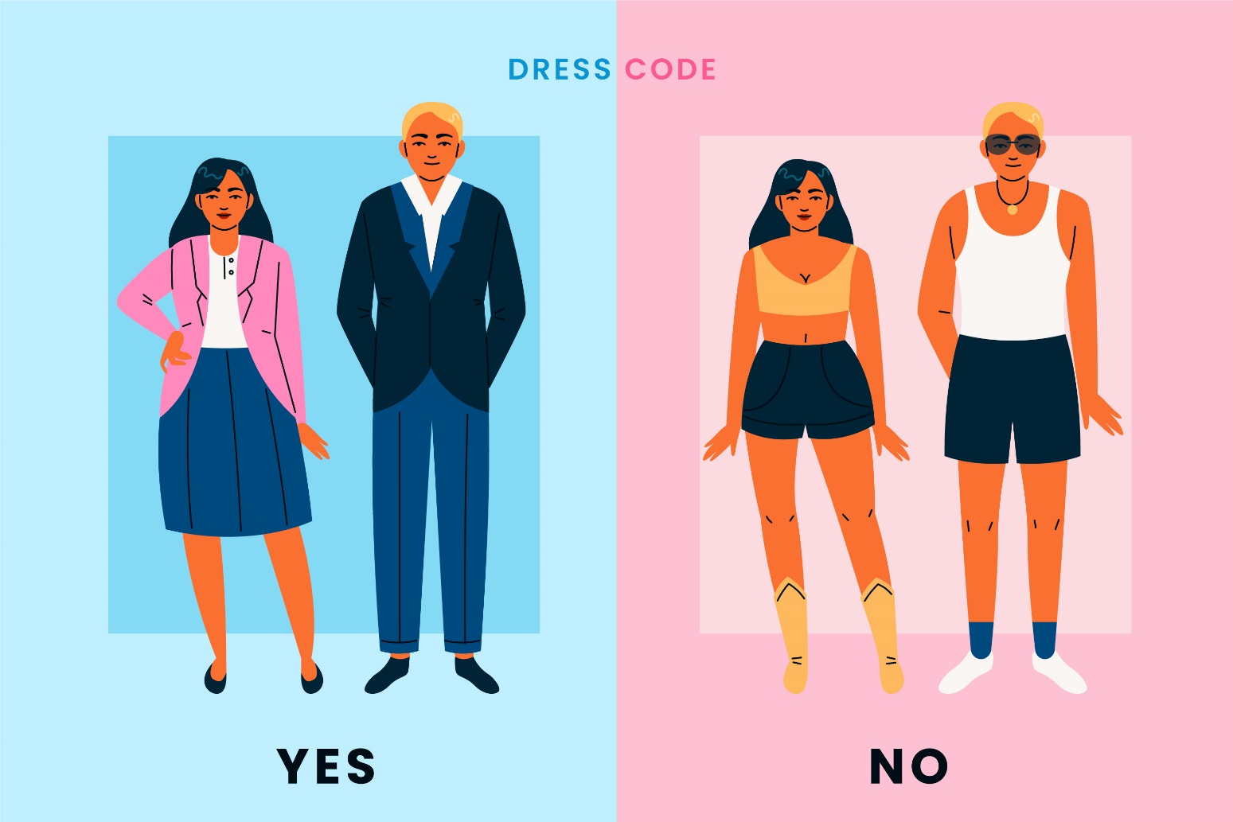
Subjective norms / Social influence (2/3)
Most social groups have their own subjective idea of how to act appropriately. These are norms, which are a vital part of the identity of the social group.
To be a part of the group is to adhere to these subjective norms. This can cause people to change their behaviour (intentionally or unintentionally) in order to conform to these norms.
Example: following a dress code for a job.
When a part of the identity of the group is to follow certain untrustworthy media outlets or to believe certain unproven (conspiracy) theories for example, which is the case for many online communities, new potential members would be prone to conform.
Image by Freepik

Slide 14
Subjective norms / Social influence (3/3)
Other ways in which someone’s environment can influence the behaviour of believing in false information:
People tend to exert less effort or think less critically when in a group (social loafing).
Group members can persuade a person’s attitudes and beliefs through communication and argumentation.
When group members ask for a change in behaviour, a person is more willing to comply.
Conclusion
Due to these factors, a person has a higher chance of accepting information as truth when the majority of their social group believes in the information.

Slide 15
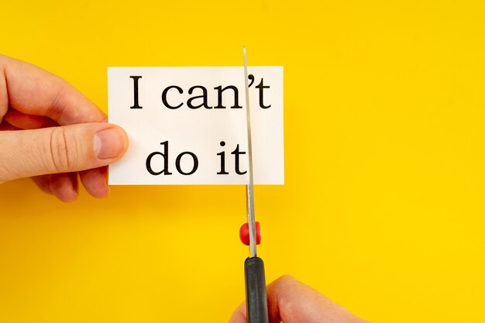
Perceived behavioural control (1/3)
Perceived behavioural control refers to a person's perception of the ease or difficulty of performing the behaviour of interest.
It is closely related to self-efficacy, which is someone's belief in their ability to accomplish a goal.
In the case of belief in (false) information, this perception of control can be influenced by the following concepts:
Source definition | Image by Freepik

Slide 16
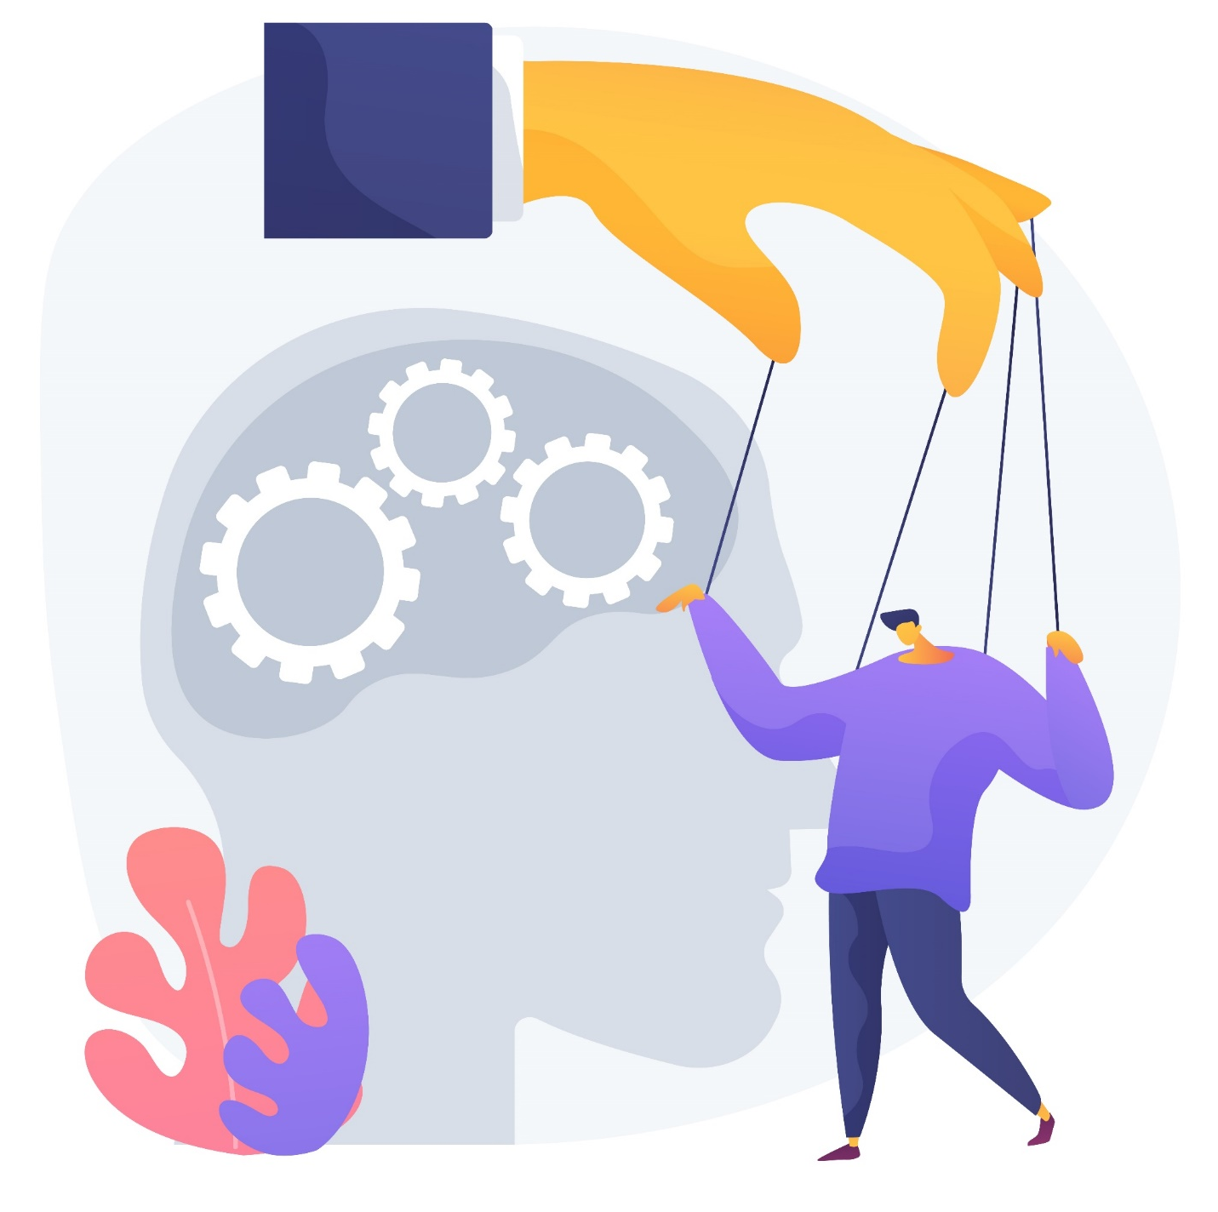
Perceived behavioural control (2/3)
A lack of credible sources: when someone only gets information from unreliable sources, they are more likely to run into false information. Without opposing information, the false information is more likely to be accepted as truth;
Limited knowledge or expertise: without background information, it becomes easier to accept false information as true;
Lack of media literacy: insufficient understanding of how to critically assess and evaluate information;
Emotional reasoning: emotions influence reasoning. When a person has strong emotional attachments, they may be more inclined to accept information which supports this emotional state, even when it is false;
Image by vectorjuice on Freepik.

Slide 17
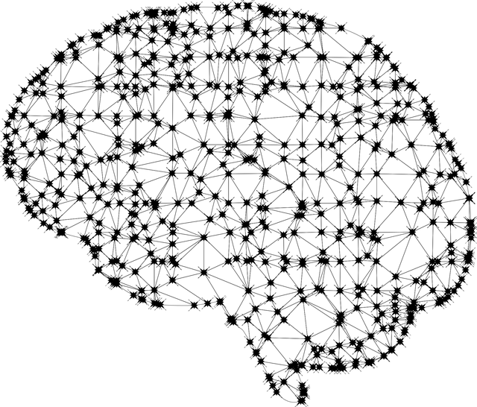
Perceived behavioural control (3/3)
Confirmation bias: the tendency to accept information which confirms pre-existing beliefs more quickly than other information, even if the information is false;
Cognitive shortcuts: people do not think critically about everything: sometimes people use heuristics or “shortcuts”. Everyone does this, however, whenever used in the wrong scenario, it can cause acceptance of false information. This is especially prevalent when the subject is not seen as important.
Source |Pixabay License

Slide 18

Skills to identify belief in mis- and disinformation
Source |Pixabay License

Slide 19
Skills to identify belief in disinformation (1/3)
Keep up to date with popular narratives in media, so that you are aware what is happening in disinformation.
Be vigilant for "red flag" signals. These are signs that indicate radicalisation, which is often a product of belief in disinformation.
When you have observed some troubling opinions, statements or arguments, try to start a dialogue about it. More on this can be found in Module 4: Enabling Dialogue.
Context-dependent:
Belief in (mis- and) disinformation can vary extensively between different individuals. There is not one true fix or skill to counteract it. However, there are some general skills to keep in mind.

Slide 20

Red flag signals (2/3)
There is no exhaustive checklist covering all possible signals which could indicate radicalisation, because this subject is too complex and context-dependent. The process of radicalisation is constantly changing and evolving, and therefore the indicators of it as well.
However, here are some examples to show what these signals could look like:
Source |Pixabay License

Slide 21

Examples of red flag signals (3/3)
The use of problematic statements or language known to be affiliated with disinformation or radical groups, for example emphasising us-versus-them divisions related to ethinicity or religion.
An increasing sense of belonging to a particular (political, religious, ethnic) group, or contrarily, feeling like they do not belong anywhere.
Breaking off old friendships in favor of new friends from a radical group.
Changes in mood and/or isolating oneself.
Noticeable changes in (school) performance or absenteeism.
Engagement in different leisure activities.
Participating in demonstrations.
Rejecting attitude towards society and authorities.
Radical changes in clothes or appearance.
Recent exposure to one or more trigger factors.
Source |Pixabay License

Slide 22
References and further reading
The guidelines of the COSTAID-project on costaid.eu, on which these slides are based.
Ajzen, I. (1991). The theory of planned behavior. Organizational Behavior and Human Decision Processes, 50(2), 179–211. https://doi.org/10.1016/0749-5978(91)90020-t
RAN Practitioners. (2023). How to respond to disinformation in public communications from the perspective of frontline practitioners. Radicalisation Awareness Network. https://home-affairs.ec.europa.eu/system/files/2023-07/ran_cn_paper_how_to_respond_to_disinformation_in_public_communications_27-29032023_en.pdf
Santos-d’Amorim, K., & Miranda, M. (2021). Informação incorreta, desinformação e má informação: Esclarecendo definições e exemplos em tempos de desinfodemia. Encontros Bibli, 26, 01–23. https://doi.org/10.5007/1518-2924.2021.e76900

Slide 23
Congratulations!
You have completed this part
Funded by the European Union. Views and opinions expressed are however those of the author(s) only and do not necessarily reflect those of the European Union or the European Education and Culture Executive Agency (EACEA). Neither the European Union nor EACEA can be held responsible for them.

