Slide 1



https://www.costaid.eu
Module 2 Critical thinking
Funded by the European Union. Views and opinions expressed are however those of the author(s) only and do not necessarily reflect those of the European Union or the European Education and Culture Executive Agency (EACEA). Neither the European Union nor EACEA can be held responsible for them.

Slide 2







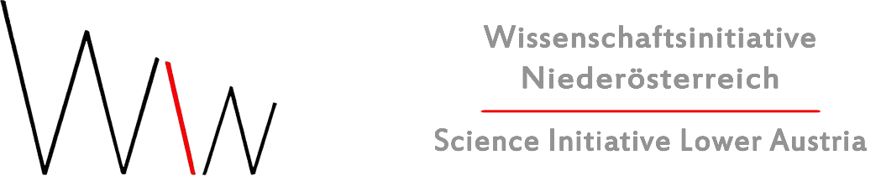
Partners

Slide 3
Modules
4. Enabling dialogue
5. Ethics
6. Reflective skills
7. Digital skills
1. Awareness
2. Critical thinking
3. Conflict solving

Slide 4

Objectives
To demonstrate how critical thinking is important for dealing with information disorder
To explain what critical thinking is and what its components are
To illustrate the tools that both individuals and educators can use for critical thinking and that help build critical thinking skills

Slide 5

What is critical thinking?
Critical thinking is a concept that has its roots in three academic disciplines: philosophy, (cognitive) psychology, and education.
The philosophical approach focuses on the hypothetical critical thinker, and on the qualities and characteristics of this person as an “ideal type” rather than the behaviors or actions the critical thinker can perform.
The psychological approach focuses on how people actually think versus how they ideally should think. Critical thinking here is defined by actions or behaviors that critical thinkers can perform.
The educational approach is based on observations of student learning and views critical thinking within a hierarchical taxonomy of cognitive information processing skills, with comprehension at the bottom and evaluation at the top, and the three top levels (analysis, synthesis, evaluation) representing critical thinking.
Source | Image source

Slide 6

Components of critical thinking
1. Abilities (skills)
Analysis of arguments, claims, and evidence
Making inferences using inductive or deductive reasoning
Judging or evaluating information
Making decisions and solving problems
2. Dispositions (attitudes, habits of mind)
Open-mindedness
Fairness
Propensity to seek reason
Curiosity
Desire to be well-informed
Flexibility
Empathy
3. Importance of background knowledge
Domain-specific knowledge is crucial, as evaluations and evidence vary highly from one domain to another
Too much value is lost if critical thinking is seen as simply a list of logical operations
Source | Image source

Slide 7
Critical thinking for dealing with information disorder
Critical thinking for dealing with information disorder concerns the ability to question information that individuals see, and the ability to distinguish between high-quality and unreliable content
Research indicates that, on the whole, students often lack the necessary skills to effectively navigate information disorder.
To address this issue, it is crucial to provide education on information disorder and to promote initiatives that stimulate critical thinking among students. These measures are vital for enabling students to construct their own internal cognitive “firewall” that can safeguard them against the perils of information disorder.
Source

Slide 8
A multiliteracies framework
The rapid changes around information disorder in the digital age require a wide array of knowledge and skills in order for individuals to be able to deal with information disorder in an effective way.
The “multiliteracies” framework contains skills for dealing with information disorder combined with knowledge about factors that contribute to information disorder. This allows for a dynamic framework of skills and knowledge that can be expanded upon as the landscape of information disorder shifts and changes in the future. Key components include:
  (Critical) media literacy
  Information literacy
  News literacy
  Algorithmic literacy
  Statistical/quantitative literacy/numeracy
  Knowledge of power and implications of artificial intelligence
Source

Slide 9

Thinking, fast and slow
When presented a piece of information, individuals can engage in one of two ways of information processing: systematic processing or heuristic processing.
Systematic processing encompasses careful, thorough analysis of the evidence that is present to arrive at a well-founded credibility evaluation. Systematic evaluations require substantial mental effort.
Heuristic processing is characterised by a rather intuitive use of heuristics or rules-of-thumb that require little to no cognitive effort, to arrive at a quick credibility judgment.
Critical thinking concerns taking the time to engage in more detailed and specific processing when confronted with news or information, by considering the time needed to reflect on the source of the information, its reliability and credibility, its biases, the possible agenda that underlies it.
Source 1 | Source 2 | Source 3
Image source

Slide 10

Sceptical knowing
In their work, journalists and fact-checkers engage in systematic processing and evaluations of information using the following six questions, which make up the principle of “sceptical knowing”.
Type: What kind of content is this?
Source: Who and what are the sources cited and why should I believe them?
Evidence: What is the evidence and how was it vetted?
Interpretation: Is the main point of the piece proven by the evidence?
Completeness: What is missing? What might be an alternative explanation or understanding?
Knowledge: Am I learning every day what I need?
Source | Image source

Slide 11
Critical ignoring
The complex digital environment containing constant stimuli competing for our attention make it difficult, if not impossible, to use these six questions with each piece of information we encounter.
Instead of promoting critical thinking about any piece of information, it is important that we know which information we can invest our limited cognitive/attentional capacities in, and which information is better to ignore in order to not deplete our mental resources.
This balance between knowing what to ignore online and where to invest time and effort is known as “critical ignoring”. Critical ignoring constitutes a paradigm shift for educators from focusing on analysing information to the power of ignoring information. Critical ignoring is seen as a new critical thinking for the digital age.
Source 1 | Source 2

Slide 12

Three tools for critical thinking
Self-nudging involves the use of situational control strategies to effectively handle exposure to distracting and hard-to-resist stimuli. This strategy conserves the autonomy and agency of users, and helps in regaining control over their information environment.
  For example, setting time limits on social media, setting screen in grayscale.
Lateral reading concerns checking information by leaving the source and verifying the information using a different source elsewhere.
  For example, checking multiple news sites about the same reported event.
“Do not feed the trolls”-heuristic concerns being aware of not engaging with and rewarding malicious online actors with attention.
  For example, by blocking and reporting them
Source 1 | Source 2 | Image source

Slide 13
Building critical thinking while avoiding scepticism, cynicism, and distrust
While teaching critical thinking about information to students, it is important to pay attention to not stimulate exaggerated scepticism, cynicism, and distrust of media.
There is a fine line between healthy scepticism and distrust: despite its good intentions, media literacy education could teach students to distrust online information without equipping them with the necessary skills to determine themselves whether a piece of online information is credible.
This evolution might result in a general distrust of the media and bad credibility evaluation methods that encompass selective research that only reaffirms pre-existing beliefs.

Slide 14
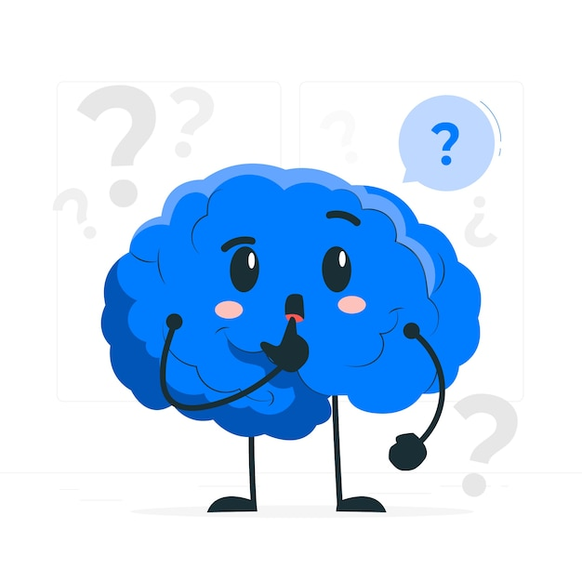
Awareness of cognitive biases
To avoid exaggerated scepticism, it is important that educators teaching critical thinking about online information not only focus on the media, but also on individuals’ own potential fault lines or cognitive biases.
This encompasses teaching how people’s fundamental beliefs have an impact on the way that they relate to information and news; and what might be done to help them become more judicious in their approach to information.
An example of cognitive bias is confirmation bias, which occurs when individuals have the tendency to gravitate towards information that confirms their pre-existing worldview, rather than information that deviates from it. Research shows that misinformed people do not change their minds once they have been presented with facts that challenge their beliefs; rather they are likely to become more attached to their mistaken beliefs.
Source 1 | Source 2 | Image source

Slide 15
The power of curiosity for critical thinking
To prevent confirmation bias and foster openness to diverse worldviews that challenge their existing beliefs, simply lecturing people and telling them they are wrong is an ineffective and possibly counterproductive approach.
Instead, researchers believe that stimulating individuals’ curiosity and finding effective ways of triggering a spirit of enquiry in the education system and beyond might be the key to stimulating critical thinking, as curiosity has been shown to counteract biased information and to promote open-mindedness.
Educators are advised to devise teaching and learning approaches which enable students to be genuinely curious about the world, in such a way that they are able to make judgements about information and accept evidence that contradicts their beliefs and not simply look for information that confirms them.
Source

Slide 16
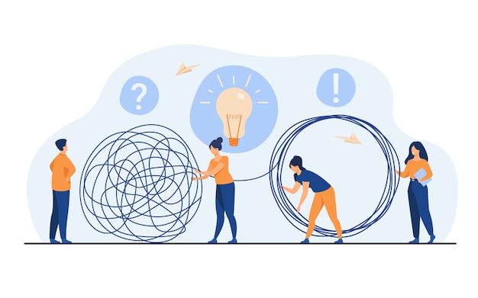
Strategies for teaching critical thinking
Researchers recommend four types of instruction for teaching critical thinking
Explicit instruction about critical thinking, also taking into account the dispositional/affective component of critical thinking.
Collaborative or cooperative learning, where social interactions and relationships are important for developing critical thinking skills. Collaborations create opportunities for disagreements and misconceptions to surface and be corrected.
  Provide students with common background knowledge in which to collaborate
  Provide groups with questions or analytical frameworks that are a bot more sophisticated than they would tend to use on their own
  Structure activities by assigning specific student roles and by creating incentives
Source | Image source

Slide 17
Strategies for teaching critical thinking
Modeling, where teachers model critical thinking in their own instruction by making reasoning visible/clear to students
  Use “thinking aloud”, so students can observe teacher using evidence and logic to support arguments and assertions
  Use concrete examples that are relevant for teaching abstract concepts such as “conflicts of interest”
Constructivist techniques, where students take the lead in their own learning and the role of the teacher is de-emphasised.
Source

Slide 18
References and further reading
Damasceno, C. S. (2021). Multiliteracies for combating information disorder and fostering civic dialogue. Social Media +. https://doi.org/10.1177/2056305120984444
Goldstein, S., Secker, J., Coonan, E., & Walton, G. (2017). Written evidence submitted by InformAll and the CILIP Information Literacy Group (FNW0079). Retrieved from: https://data.parliament.uk/writtenevidence/committeeevidence.svc/evidencedocument/culture-media-and-sport-%20committee/fake-news/written/48215.html
Jones, D. (2016). Seeing reason. Human brains skew facts. How can we change our minds? New Scientist, 232 (3102), pp.28-32.
Kahneman, D. (2011). Thinking, fast and slow. London: Penguin
Kozyreva, A., Wineburg, S., Lewandowsky, S., & Hertwig, R. (2023). Critical ignoring as a core competence for digital citizens. Current Directions in Psychological Science, 32(1), 81–88. https://doi.org/10.1177/09637214221121570
Lai, E. R. (2011). Critical thinking: A literature review. Pearson’s Research Reports, 6(1).
Lewandowsky, S., Ecker, U. K. H., Seifert, C. M., Schwarz, N., & Cook, J. (2012). Misinformation and its correction: Continued influence and successful debiasing. Psychological Science in the Public Interest, 13(3), 106–131. https://doi.org/10.1177/1529100612451018
Metzger, M. J. (2007). Making sense of credibility on the Web: Models for evaluating online information and recommendations for future research. Journal of the American Society for Information Science and Technology, 58(13), 2078–2091. https://doi.org/10.1002/asi.20672
Rosenstiel, T. (2013). Six questions that will tell you what media to trust. American Press Institute. Retrieved from: https://americanpressinstitute.org/publications/six-critical-questions-can-use-evaluate-media-content/

Slide 19
References and further reading
Stanford History Education Group, (Nov. 22, 2016) Evaluation Information: The Cornerstone of Civic Online Reasoning. https://sheg.stanford.edu/upload/V3LessonPlans/Executive%20Summary%2011.21.16.pdf
Sundar, S. S. (2008). The MAIN model: A heuristic approach to understanding technology effects on credibility. In M. Metzger & A. J. Flanagin (Eds.), Digital media, youth, and credibility (pp. 73–100). Cambridge, MA: The MIT Press. https://doi.org/10.1162/dmal.9780262562324.073
Trevors et al. (2017). Exploring the relations between epistemic beliefs, emotions, and learning from texts. Contemporary Educational Psychology, 48, 116–132.
Wardle, C., & Derakhshan, H. (2017). Information disorder: Toward an interdisciplinary framework for research and policy making. Strasbourg. Retrieved from: https://edoc.coe.int/en/media/7495-information-disorder-toward-an-interdisciplinary-framework-for-research-and-policy-making.html
White, A. (2022). Overcoming ‘confirmation bias’ and the persistence of conspiratorial types of thinking. Continuum: Journal of Media & Cultural Studies, 36(3), 364–376. https://doi.org/10.1080/10304312.2021.1992352
World Economic Forum (2023). Critical thinking is great, but in a world full of information we need to learn 'critical ignoring‘. Retrieved from: https://www.weforum.org/agenda/2023/02/critical-thinking-ignoring-brain/

Slide 20
Congratulations!
You have completed this part
Funded by the European Union. Views and opinions expressed are however those of the author(s) only and do not necessarily reflect those of the European Union or the European Education and Culture Executive Agency (EACEA). Neither the European Union nor EACEA can be held responsible for them.

